Slide 1
Children and Young People’s Mental Health
Adverse Childhood Experiences
‘You Keep Talking We keep Dying’
Social Justice Resilience and Resistance
Sally Amor
Child Health Commissioner/Public Health Specialist
Notes:
I am really pleased to be here today to explore the risks and opportunities of working through a public health lens to understand the importance and role of adversity in childhood (adverse childhood experiences) as we look to understand social justice resilience and resistance in the lives of children and young people and their mental health and wellbeing
Why does this matter?
The ACE Aware Nation movement in Scotland has seen extensive debate and discussion over the risks and opportunities of understanding our lives through a lens of adversity in Scotland.
I have used the strap line of ‘You keep talking We Keep dying’ intentionally Because while we debate the ins and outs of policy and practice we run the risk of not listening to the voices of experience at the sharp end of where 3 people are dying a day in Scotland: mothers fathers, uncles, aunts, sisters and brothers and where the stories of adversity and sometimes intergenerational effects of adversity can no longer be avoided
Public health can be viewed in history as a movement of social justice and resistance: bringing awareness to the issues that wider society and vested interests might prefer to keep hidden in plain sight Be that poor water, housing conditions, the use of seat belts or alcohol or tobacco related harm.
By rolling with the understandable resistance to emerging knowledge we have see widespread societal shifts and change that work for the better. A social justice approach seeks to create environments that underpin and support resilience as I will explore in this paper.

Slide 2
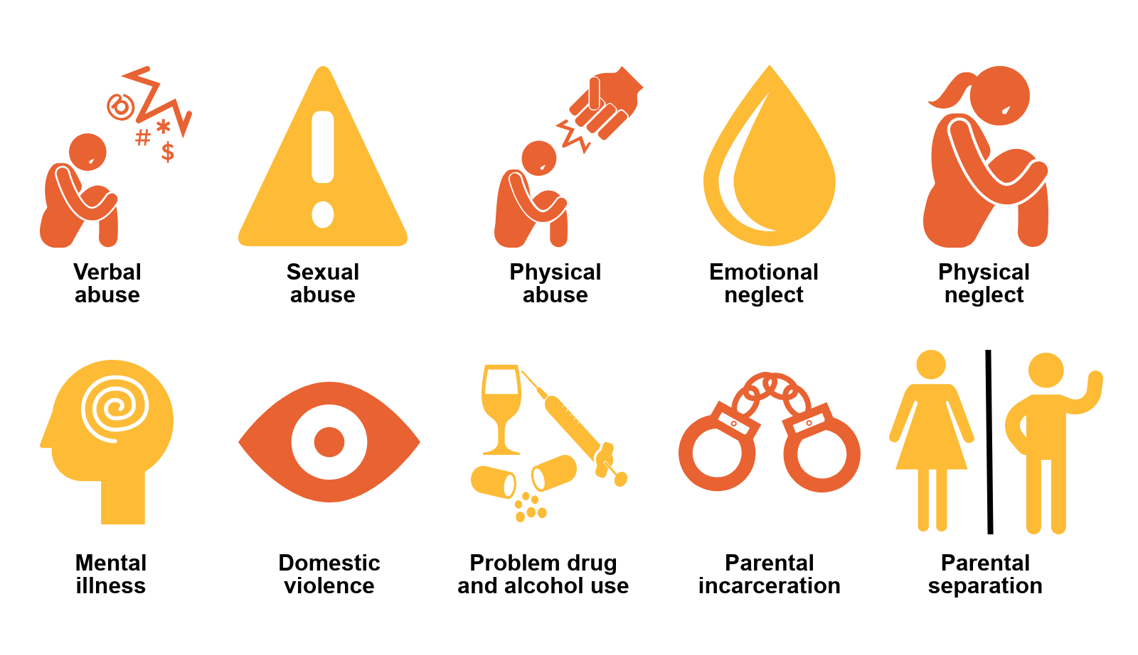
Notes:
Adverse childhood experiences are common to many of us: they reflect key stressful events from before birth, to the age of 18. There should be no shame in having experienced adversity.
The original 1998 Fellati study focused on primary experiences of adversity in the home
Domestic abuse
Mental illness
Drug misuse
Alcohol misuse
Child sexual abuse
Physical abuse
Emotional abuse
Death of a parent
These original markers of adversity recognise the primary role of parents and the family for mediating child wellbeing and the means by which we develop a coherent sense of self as we grow and develop

Slide 3
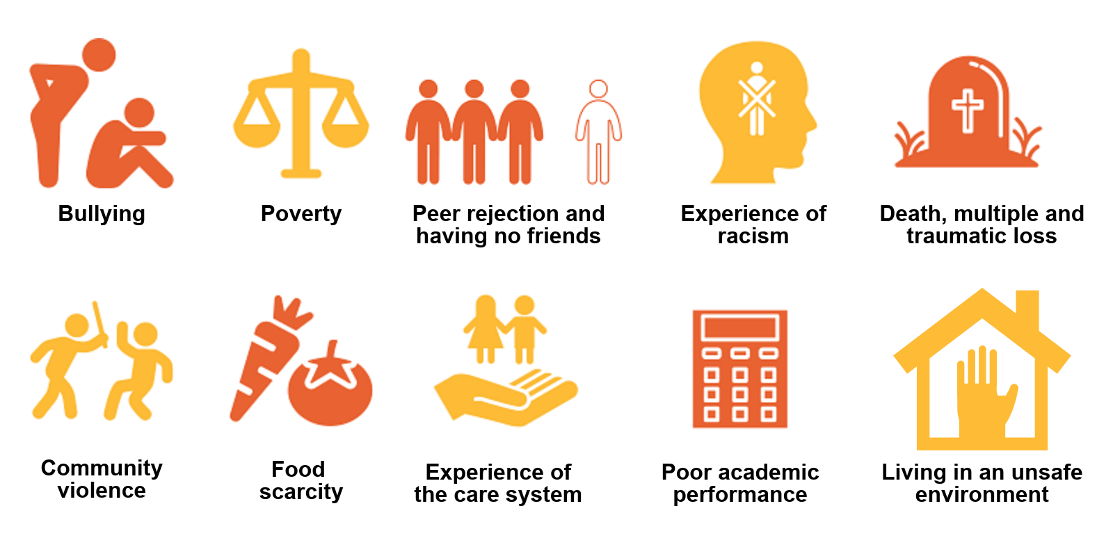
Notes:
In addition to the markers of adversity in the home as captured in the original ACE study further research has identified these additional experiences of adversity that can impact across lives
Population studies show a risk relationship between the experience of multiple adversity and poorer outcomes in life in terms of physical and mental health and adopting health harming behaviours
Babies (and also children and teenagers) do best when they have responsive and attuned care givers to buffer the effect of stress fear and anxiety. This lays the basis for health and wellbeing across the life course by laying down the neural pathways that we take through our lives
At its simplest, the ACE aware movement in Scotland is about understanding human suffering and how best we can respond from a position of curiosity A moment of pause
We would be thoughtful about mocking the power of kindness and compassion when we look at what happens in the wider world when this is set aside
The discussion also involves complexity
The neural pathways that are laid down in infancy and revisited in adolescence also interact with the wider physiological mechanisms and feedback loops that shape our physical health over time
They are complex and we have much still to learn
Shared learning and a growing awareness of the interconnected nature of the many complex systems across these topics are bringing a diverse range of research interests together to create a powerful body of knowledge and much debate and interest from neuroscience to metabolic and immunology to anthropology/culture and systems thinking

Slide 4
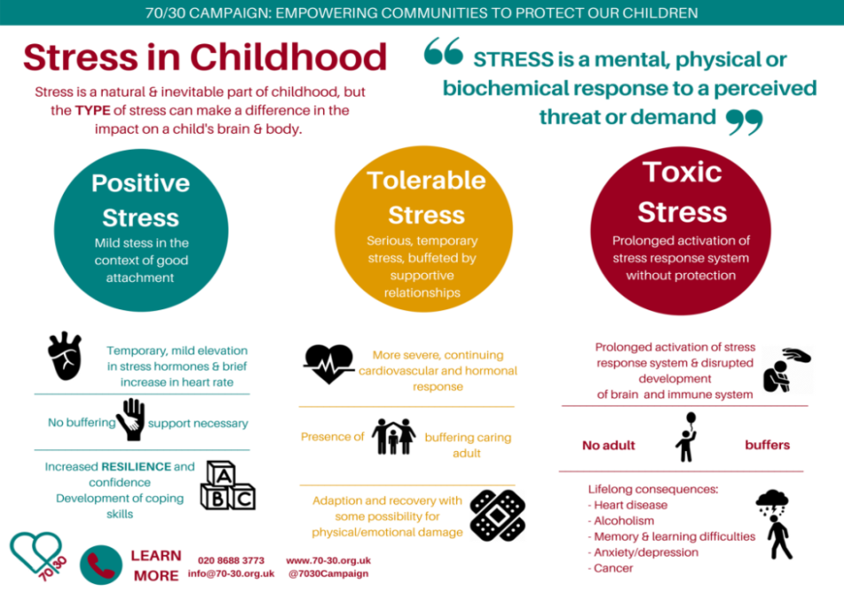
Notes:
While some stress and distress serves a necessary developmental purpose that underpins resilience
Multiple experiences of adversity can lead to what has been termed ‘Chronic toxic stress’. This is where the harm from unbuffered adversity/stress can occur Where a infant child or teen’s system is overloaded Where there is sense of a safe other adult Where there is minimal or no safety Relational and or environmental When immature bodily systems are overwhelmed
Some of the discomfort perhaps comes from an increased awareness of the vulnerability of babies to their environments If we understand how we are born with our brains still in development we will see the importance of this Particularly powerful are the first 1001 days of life In utero and into toddlerhood Where neural pathways are being created in their millions by the minute and revisited in adolescence
This can have a lasting effect on physical and mental health and wellbeing from birth to the older years. We are increasingly understanding how these effects can be passed on to further generations, which can cause intergenerational harm.
Chronic toxic stress can alter the way our brains develop and result in a dis-regulated stress response Fright Flight Fight.
This means that in school children and adolescents can be see as reactive disruptive and challenging Or quiet and withdrawn.
into adulthood we can find ourselves in fright fight or collapse mode when we feel threatened or under pressure in adult relationships as parents or at work , with friends.
Interestingly, these responses can be contagious if the people around us respond in kind.

Slide 5
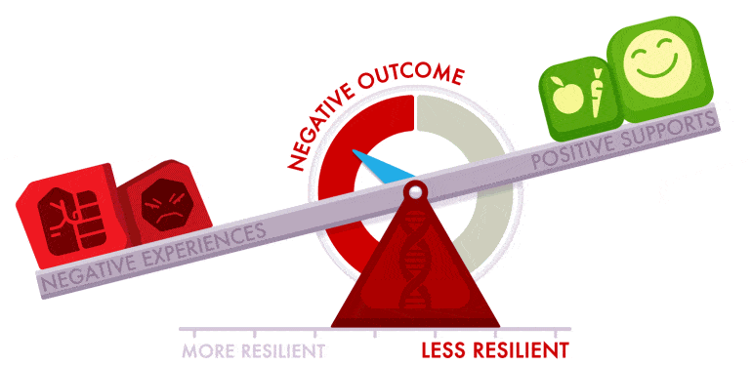
Resilience comes from an ability to biologically and psychologically adapt to stress
Notes:
We can be clear that experience of adversity in childhood is not deterministic There are many ways of offsetting risk This is not about blame or shame It is fundamentally about understanding and responding to human struggle and the suffering that can follow
The impact of adverse childhood experiences can be offset by safe, secure responsive adult relationships that buffer the effects of stress/adversity and support the development of resilience, a key mechanism to make sense of, and recover from threat and fear.
For individuals, resilience comes from an ability to biologically and psychologically adapt to stress. Relationships underpin the development of resilience. The essence of striving for stability within relationships through resilience is eloquently depicted in the Alberta Family Wellness ‘Fulcrum of Resilience’ model.
Resilience can be fostered through stronger social connections, by meeting the basic needs of children and by supporting parents to be resilient themselves and to be nurturing in their relationships with their children.
While too little buffering can present risk there are also concerns that too much buffering can also be harmful. Within the debate about adversity in childhood is the need to distinguish between what Carol Craig in her chapter in ’The Golden Mean’ From One Extreme to Another has called stretch and support not all stress is toxic Some is necessary to teach life skills that underpin resilience.
in the report we define resilience as the ability to biologically and psychologically adapt to stress, through the creation of brain pathways that integrate the different parts of the brain so we can make sense of life experiences so that life is good or at least tolerable.
Resilience has to be learnt and acquired as a key skill for life. This happens primarily through relationships. Safe nurturing relationships, particularly in the early years and into adolescence are the key to developing resilience at an individual level.
Resilience is one mechanism by which toxic stress can be transformed into tolerable stress
When we bring a wider lens of adversity what do we see?

Slide 6
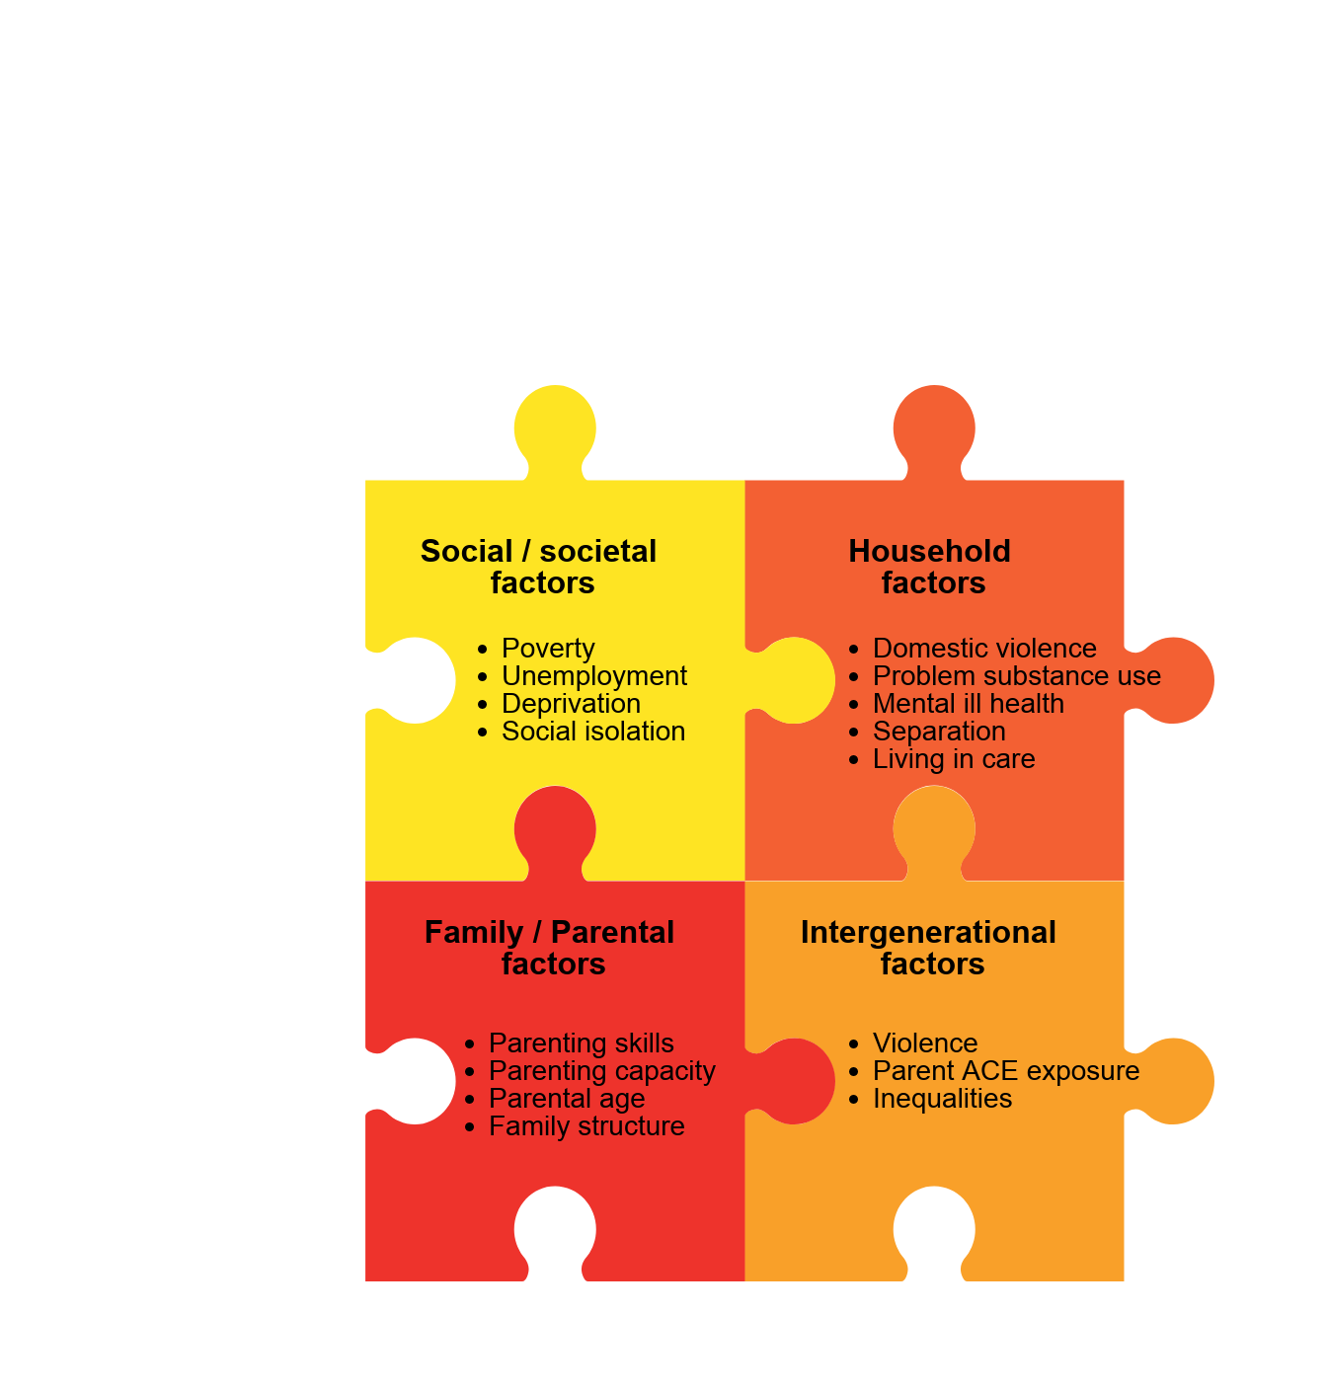
Notes:
The risk factors associated with increased likelihood of experiencing adversity through abuse, trauma and stress in childhood are extremely varied involving an inter play between society household family/parenting and intergenerational effects
We know these risk factors are often co-occurring and interlinked, and that it is usually the cumulative effects of a combination of factors, rather than a single issue that leads to a child’s experience of adversity and stress.
To better understand the relationship between poverty and abuse of children we can look at a review undertaken by the Joseph Rowntree Foundation who undertook an evidence review of the relationship between poverty and child abuse and neglect in 2016
Conclusions included that
Poverty is neither a necessary or a sufficient factor in child abuse and neglect
There are both direct and indirect impacts from poverty that can interact with other influences on parenting such as
parenting capacity can be affected by mental or physical illness, learning disability a lack of education, shame and stigma
Family capacity for investment to buy care respite or a better environment
Negative adult behaviours such as domestic violence, drug/alcohol misuse perhaps provoked by family stress
The inter actions between poverty and abuse and neglect are complex and frequently circular
Evidence from the US demonstrates the causal link between poverty and abuse and neglect where family incomes were raised and abuse and neglect rates fell
Part of the learning for both research and practice journey, is to better learn and understand the relationships and the impact of adversity/threat in the home and adversity/threat in the wider environment and critically How to best respond where shifts to what is termed trauma informed practice has a key role to play

Slide 7
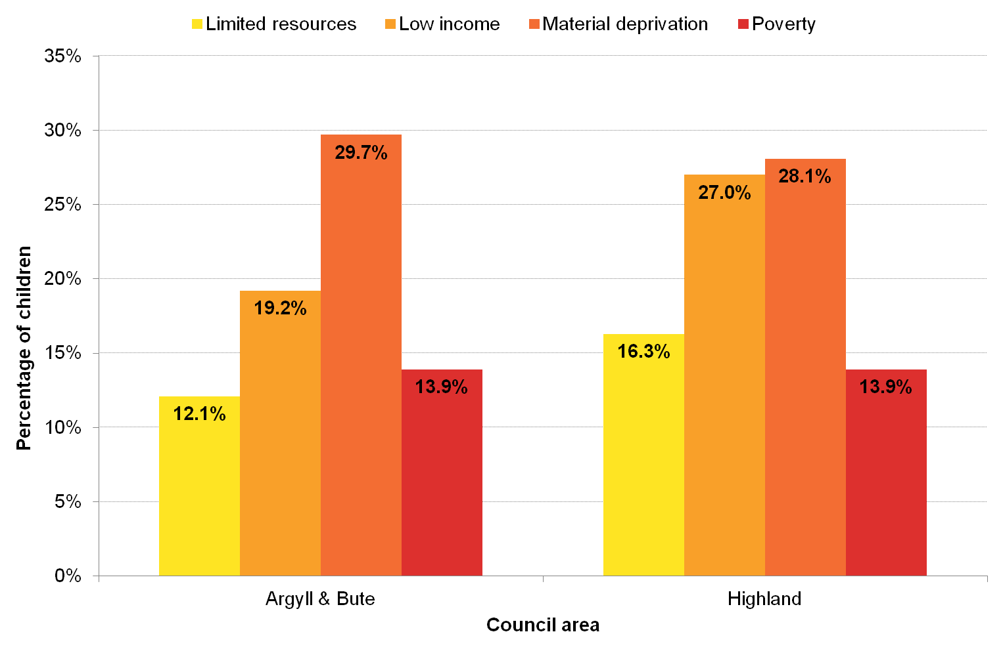
Notes:
The social context in which families live is a key risk factor for adverse childhood experiences.
While it is clear that most children who live in poverty or socio-economic disadvantage are not subject to toxic stress, there is still a strong association between low family income, unemployment, social isolation and increased risk of adverse childhood experiences.
Scottish research has found that 24% of mothers in the lowest income quintile had poor mental health in the first four years of their child’s life compared to 6% of mothers in the highest income group. There is also evidence that poverty is a major contributor to distress, relationship breakdown and conflict within families¹³.
Children are considered to be living in poverty if they live in households with less than 60% of median UK household income (before housing costs) or in receipt of Income Support or Income-Based Job Seekers Allowance.
The latest child poverty estimates show that for every 20 children in Highland, three are living in poverty. This equates to 8,200 children across NHS Highland (2,100 in Argyll and Bute and 6,100 in Highland) at increased risk of experiencing adversity thorough the social context in which they are growing up.

Slide 8
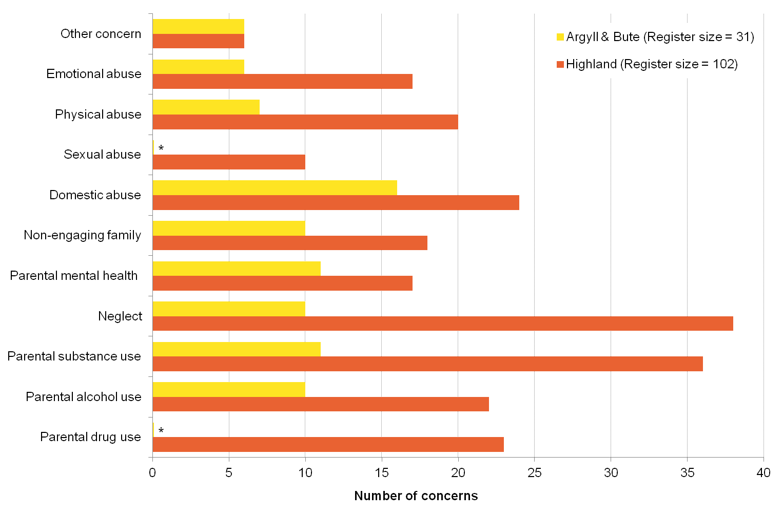
Notes:
Household risk factors for adversity for children include include domestic violence, parental divorce and separation, parental problem substance use and mental ill health.
These have both direct negative impacts on children and young people, and act as a risk factor for child abuse or neglect. This is seen in NHS Highland, where the commonest categories of child protection concerns are related to parental substance use, neglect and domestic abuse
Research also shows that children and young people in the care system, an already vulnerable population, are disproportionately exposed to household risk factors. One US study found that children in foster care were significantly more likely to be exposed to household problem alcohol and drug use (54% compared to 10%) and violence (31% compared to 8%) compared to other children.
The latest data shows that over 220 children and young people in NHS Highland are referred to the Scottish Reporter on offence grounds each year. These children and young people, who are involved in the criminal justice system, are at increased risk of experiencing adversity associated with loss and bereavement in their families. This includes bereavement of an immediate family member and losses due to parental separation, parental substance use and parental imprisonment. Scottish research has found that over two thirds of young people in custody had experienced traumatic bereavements and multiple losses by the age of 20.
Watching Darren McGarvey’s Scotland this week on drug deaths in Dundee we witness the devastating impact and intergenerational effects of problematic drug use
In Highland with 40% of the land mass and just 6% of the population we too are witnessing increasing drug deaths and a worrying trend of younger deaths than the rest of Scotland

Slide 9
Notes:
Parental and family factors, such as a child having young parents, living in a lone parent household, or parents with poor parenting skills, have also been linked with increased risk of experiencing adverse outcomes. There is evidence that parenting factors are related to, and interact with, other risk factors such as poverty, parental mental ill health and problematic substance use¹³.
Growing Up in Scotland (GUS) is a longitudinal research project tracking the lives of over 10,000 Scottish children. The GUS study has demonstrated that mothers under the age of 20 tend to have a lower income, lower levels of educational attainment, poorer health behaviours and health outcomes, more unstable partner relationships and lower levels of engagement with formal parenting support (Figure 4.10). Exploratory analyses from GUS show that by the age of eight, 11% of Scottish children have three or more adverse childhood experiences, and that having a mother aged under 20 years doubles this risk.
This is not to stigmatise young mums: it is about understanding the troubles and struggles they bring to being a parent. When this is understood with compassion and curiosity Rather than blame We create opportunities in many ways for better outcomes For infants and their parents as demonstrated in the outcomes from the Family Nurse Partnership

Slide 10
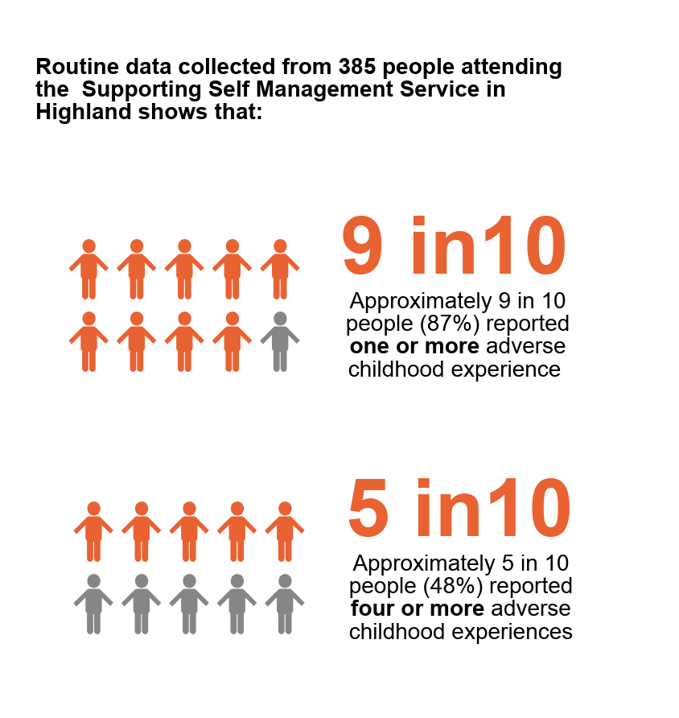
5.8x
10x
more likely to develop problematic alcohol use
more likely to develop problematic drug use
6.1x
14x
15x
more likely to receive treatment for mental illness
more likely to be a victim of violence
More likely to be a perpetrator of violence
Notes:
When we go back to the original study identified a correlation of risk with regard to experience of adversity in the home and later outcomes in life.
There were increased risks where more than four of the markers had been experienced.
At a population level, for 11 out of 100 adults in the Highland will have experienced more than 4 of the markers of adversity with the associated risk of poorer outcomes with regard to:
Mental illness
Substance misuse
Alcohol misuse
Inter personal violence
These are reflected in the experience of adversity in childhood self reported by adults accessing the Supporting Self Management Service in Highland where we see a marked increase in the experience of both one and four of the markers of adversity
-
Adversity is common and more common than we have appreciated. In the film Resilience Dr Anda one of the researchers reflected how he wept when is saw the level of distress and violence in family life as captured in the data. It might be a cultural avoidance of understanding family distress that creates the challenge to seeing the impact of adversity in family life. Do we need to get braver and or more curious? To be able to hold more than one reality at any point in time? Very few parents set out to intentionally harm their children Most do their very best with the knowledge skills and capabilities that they have
More work is required to understand the causation of the effect and this work is ongoing with regard to genetics and epigenics, biological markers, immunology and studies regarding our metabolic and immunology systems.
As we can see from the slide, the impact of adversity on the lives of adults in the home, in the moment and the impact on babies children and young people over time can be seen as far reaching: a perfect storm for family distress particularly when we look at the interaction between some of the shared and common markers for concern: drugs, alcohol, mental illness
Lets remind ourselves of the value and importance of being clear that experience of adversity need not equate to poor outcomes
When there are adults who can buffer the effect of stress on a baby child or young person this is very protective and promotes resilience, the ability and capacity to respond in healthier ways to stress.
Safe adult relationships are key to creating and responding to adversity and trauma
When the adults in a child’s life are struggling to meet their own needs how do we understand and respond? With judgement or curiosity? And critically, how do we support their child or children in the meantime as we support and seek to understand and work with them to address the barriers that may be limiting their parenting capacity and or skills

Slide 11
‘Experience of adversity and trauma in childhood does not mean you will become a drug addict but I have yet to meet a drug addict who does not have experience of trauma’
Gabor Mate 2019
Notes:
There are widespread and contested discussion as to whether it is deterministic and stigmatising to talk about experiences of adversity and trauma in childhood as as predictor of risk for poorer outcomes later in life.
Many people create fulfilling and meaningful lives with multiple experiences of adversity. Where people struggle with mental health, drug and alcohol misuse and violence there is often experience of adversity and trauma.
Gabor Mator, a Canadian physician, author and speaker with extensive experience of working with people with problematic drug use helpfully reflects this in the slide.
Relationships underpin our ability and capacity to make sense of the inexplicable from our earliest days to the here and now.
We can all be a little more thoughtful about the way we interact with ourselves and others in the day to day of our private, family, work and community relationships.
With the move to populism and concerns over the rise of the right being kind may in itself be a powerful act of resistance.

