Slide 1
Co-producing an intervention to promote resilience in young people affected by parental substance misuse
Cassey Muir (c.muir@newcastle.ac.uk)
PhD Researcher
Institute of Health & Society

Slide 2
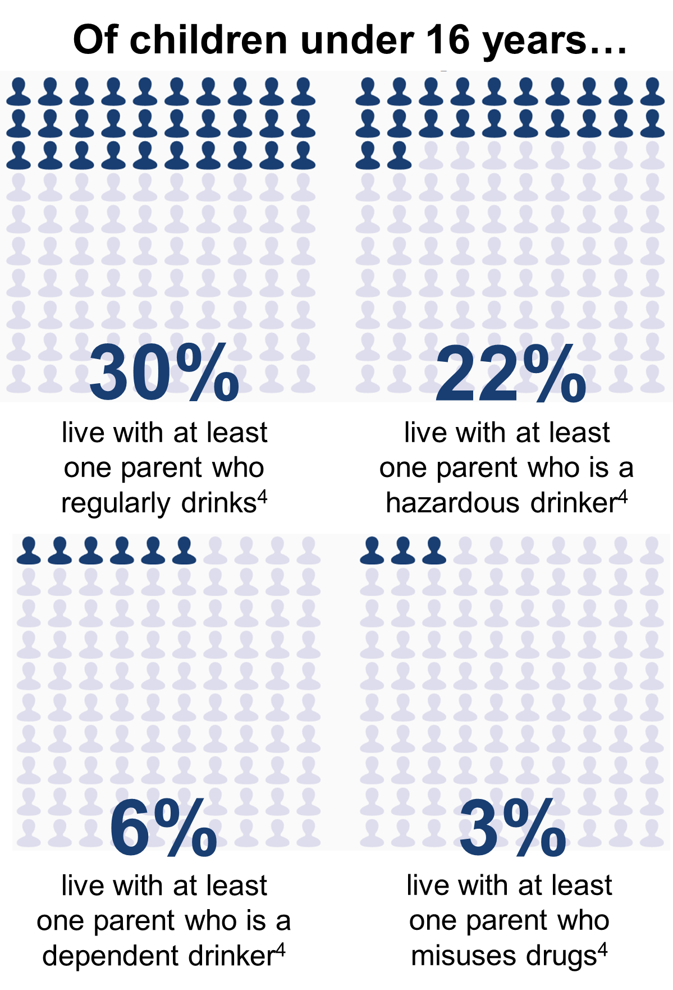
Definition & Prevalence
Parental substance misuse (PSM): dependent and non-dependent use of alcohol and/or drugs
PSM is a major child protection and public health concern¹
The prevalence of PSM is difficult to estimate due mainly to the hidden nature of the problem^{2,3}
But attempts have been made to include both dependent and non-dependent estimates^{4,5}
The number of children who experience and may be impacted by PSM is high

Slide 3
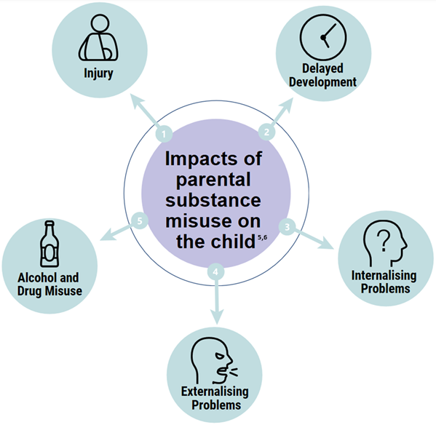
Risk & Safeguarding
The level of alcohol or drug use at which parenting becomes impaired is unclear^{5,6,7}
Continuum of risk based on level of substance misuse
But many risks for the child do not meet safeguarding levels⁸
It is important to intervene with the child at the same time as intervening to reduce parental substance misuse

Slide 4
Resilience
Not all children who are exposed to parental substance misuse subsequently develop social, emotional or behavioural problems…
…these children may be referred to as Resilient

Slide 5
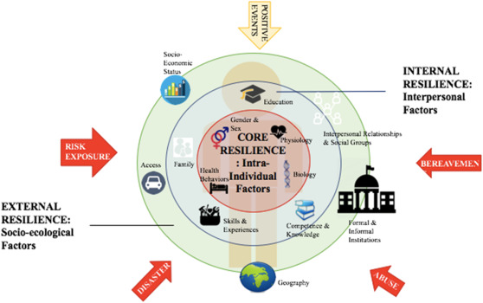
Resilience
Opposing theories
Fixed trait⁹
Flexible/adaptable and developmental¹⁰
Continuum¹¹
Different domains¹²
Interactive, multi-system approach¹³
Figure 1. Multi-systems model of resilience¹³

Slide 6
Social /Emotional Resilience in young people affected by PSM
Establish supportive/ trusting relationship with non-substance using parent or adult^{14,15}
Promote positive social support^{14,15}
Promote positive parent-child communication and relationships^{14,15}
Improve self-esteem, self-regulation, self-awareness¹⁴
Opportunity to express feelings^{14,16}

Slide 7
Aim and Proposed Methods
To co-produce a child-focused intervention to promote social and emotional resilience in young people affected by parental substance misuse
Synthesise
Qualitative Systematic Review
Co-produce
Workshops with Stakeholders
Explore
Qualitative in-depth Interviews
Prototype Intervention

Slide 8
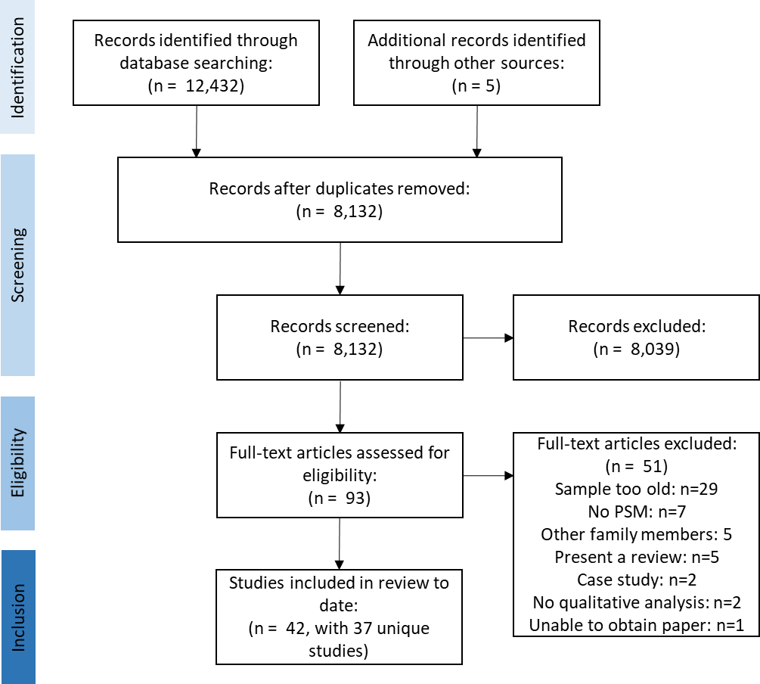
Qualitative Systematic Review: Ongoing
Synthesise
Qualitative Systematic Review
Young People’s (<25 years):
Lived experiences of PSM
Views on the impacts of PSM
Approaches and strategies to manage adverse impacts of PSM
Figure 2. DRAFT PRISMA flow diagram showing study selection process.

Slide 9
Qualitative Interviews: January 2020
Explore
Qualitative in-depth Interviews
Young People (<25 years) across the North East of England:
Experiences and impacts of PSM
Approaches and strategies to manage adverse impacts of PSM
Social and emotional resilience factors
Ideas around intervention development

Slide 10
Co-production Workshops: September 2020
Co-produce
Workshops with Stakeholders
Series of co-production workshops^{18,19}
Policy and practice partners
Young people (<25 years)
Brainstorming, persona development, ‘road-testing’

Slide 11
Prototype
Prototype Intervention
Promote social and emotional resilience among young people affected by PSM

Slide 12
Implications
Provide Awareness
Implement into Practice
Influence Policy

Slide 13
Funders
Acknowledgements
Supervisors/Collaborators
Dr Ruth McGovern and Professor Eileen Kaner, Newcastle University/Fuse Dr Judi Kidger, University of Bristol and Viv Evans, Adfam

Slide 14
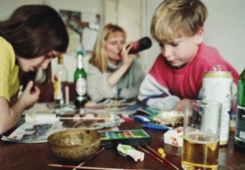
Thank you
Any questions?
Cassey Muir (c.muir@newcastle.ac.uk)
PhD Researcher
Institute of Health & Society

Slide 15
References
Canfield, M., Radcliffe, P., Marlow, S., Boreham, M. and Gilchrist, G. (2017) 'Maternal substance use and child protection: a rapid evidence assessment of factors associated with loss of child care', Child Abuse and Neglect, 70, pp. 11-27.
ACMD (2003) Hidden Harm - Responding to the needs of children of problem drug users. UK: Advisory Council on the Misuse of Drugs.
Turning Point (2006) Bottling it up: The effects of alcohol misuse on children, parents and families. London: Turning Point.
Manning, V., Best, D.W., Faulkner, N. and Titherington, E. (2009) 'New estimates of the number of children living with substance misusing parents: Results from UK national household surveys', BMC Public Health, 9.
McGovern, R., Gilvarry, E., Addison, M., Alderson, H., Carr, L., Geijer-Simpson, E., Hrisos, N., Lingam, R., Minos, D., Smart, D. and Kaner, E. (2018) Addressing the impact of non-dependent parental substance misuse upon children: A rapid review of the evidence of prevalence, impact and effective interventions. Public Health England.
Velleman, R. and Templeton, L.J. (2016) 'Impact of parents' substance misuse on children: An update', BJ Psych Advances, 22(2), pp. 108-117.
Barnard, M. (2007) Drug addiction and families. London, UK: Jessica Kingsley Publishers.
NSCB (2018) 1.1.1 Multi-Agency Thresholds Guidance & Continuum of Help and Support Framework. Newcastle upon Tyne: Newcastle Safeguarding Children Board.
Funder DC, Block J. The role of ego-control, ego-resiliency, and IQ in delay of gratification in adolescence. Journal of personality and social psychology. 1989;57(6):1041-50.
Rutter M. Resilience as a dynamic concept. Development and Psychopathology. 2012;24(2):335-44.
Fergusson DM, Beautrais AL, Horwood LJ. Vulnerability and resiliency to suicidal behaviours in young people. Psychological Medicine. 2003;33(1):61-73.
Luthar SS, Doernberger CH, Zigler E. Resilience is not a unidimensional construct: Insights from a prospective study of inner-city adolescents. Development and Psychopathology. 2009;5(4):703-17.
Liu JJW, Reed M, Girard TA. Advancing resilience: An integrative, multi-system model of resilience. Personality and Individual Differences. 2017;111:111-8.
Park, S. and Schepp, K.G. (2015) 'A Systematic Review of Research on Children of Alcoholics: Their Inherent Resilience and Vulnerability', Journal of Child and Family Studies, 24(5), pp. 1222-1231.
Wlodarczyk, O., Schwarze, M., Rumpf, H.J., Metzner, F. and Pawils, S. (2017) 'Protective mental health factors in children of parents with alcohol and drug use disorders: A systematic review', PLoS ONE, 12(6).
Moe, J., Johnson, J.L. and Wade, W. (2007) 'Resilience in children of substance users: In their own words', Substance Use and Misuse, 42, pp. 381-398.
O'Brien, N., Heaven, B., Teal, G., Evans, E.H., Cleland, C., Moffatt, S., Sniehotta, F.F., White, M., Mathers, J.C. and Moynihan, P. (2016) 'Integrating evidence from systematic reviews, qualitative research, and expert knowledge using co-design techniques to develop a web-based intervention for people in the retirement transition', Journal of Medical Internet Research, 18(8).
Hawkins, J., Madden, K., Fletcher, A., Midgley, L., Grant, A., Cox, G., Moore, L., Campbell, R., Murphy, S., Bonell, C. and White, J. (2017) 'Development of a framework for the co-production and prototyping of public health interventions', BMC Public Health, 17(1).

