Slide 1
“Constantly walking on eggshells”
“Constantly walking on eggshells”
The lived experience of siblings of adolescents with an eating disorder; using IPA and PhotoVoice
By Laura Patterson MSW, MSc
University of Northampton
MSc in Child and Adolescent Mental Health completed Feb ‘19

Slide 2
The aim of the talk
To situate me and to situate the research
To explain what I did and how I did it
To explore the findings alongside reflexive analysis and discussion and using verbatim extracts and PhotoVoice photos
To think about why my research matters
To consider the future, for me and for my participants
Notes:
At first I tried to squeeze everything from my 15000 word dissertation in to the talk and then took most of it out again, so these are the points I wish to cover today. I want it to be informative and useful but most of all I want to make you think.

Slide 3
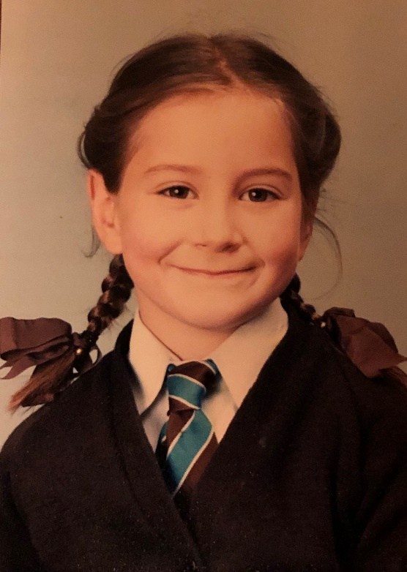
Who am I?
Return to study as adult and develop a love of qualitative research
White British, English-speaking, able-bodied, female heterosexual
Negative school experience and limited achievement
Dysfunctional family background
Experience of childhood trauma
Range of self-harm behaviours
Notes:
So, who am I? CLICK I am female, white, British, heterosexual, able-bodied, English speaking, but I don’t want people to make judgements on that basis because it’s just who I am. I have a story and our participants in our research all have a story and you too have your stories. We all have a story of struggling to survive. CLICK I grew up in an atmosphere of emotional neglect and it was devoid of warmth or affection and being privileged financially is no guarantee of anything. CLICK I had no real attachment to my parents which created a perfect arena for childhood trauma. My focus in the research is on eating disorders and this was one of the ways that I coped with my circumstances. CLICK I purged food and restricted it as part of a range of self-harm behaviours. CLICK And turbulent teens turned into turbulent twenties and it was in the midst of difficult circumstances I managed a Masters in Social Work. CLICK I returned again to study in my 40’s to discover a penchant for learning and qualitative research – receiving a distinction for my Masters and 90% in my dissertation. We all have a story.

Slide 4
Rationale for study
Research aim to explore lived experience of siblings and enable parents and professionals to know how best to offer support
Research to date has rarely focused on siblings directly (Limbers & Skipper, 2014; Sharpe & Rossiter, 2002)
Existing literature showed a primarily negative effect on siblings, describing them as “secondary victims” of an Eating Disorder (Dimitropoulos, Klopfer, Lazar & Schacter, 2009)
I reflected on my own lived experience of disordered eating during teaching on Eating Disorders on my MSc course
The study coincided with experience of working alongside families and noticing sibling displacement
Notes:
I chose this area to study partly because of my own experience and because I was working alongside three families where I could see the displacement of young people because their sibling had an eating disorder. We had some teaching on our MSc and it sparked a real interest in this phenomenon. When I went to the literature, the small body of research into the effect on siblings was often not using direct self-report to ascertain their own views. Those researchers that had spoken directly to siblings found that they presented as “secondary victims” of the eating disorder. So it made it a really important area to explore, with a need to focus on the siblings alone to hear their “voices”.

Slide 5
Method
IPA research limited to 3 participants to enable a robust analysis (Smith, Flowers, Larkin, 2009) to study lived experience phenomenologically (Jones, 2015)
Recruitment was via word-of-mouth
Used one semi-structured interview and PhotoVoice (Wang, 1999)
“The pictures were worth a thousand words” Nykiforuk, Vallianatos and Nieuwendyk (2011, p. 120)
Reflexivity enabled a hermeneutic analysis (Finlay, 2008, 2011), Burkitt (2012), Boden, Gibson, Owen and Benson (2016) and Letherby (2003).
Ideographic approach (Shinebourne, 2011) , inductive ‘bottom-up’ research (Smith et al. 2009) with a focus on the meaning of the experience
Theoretical perspectives – feminist theory (Finlay, 2003), sociocultural theory (Vygotsky, 1978) , theory of sibship (Punch, 2005, 2008, 2017)
Notes:
In the research I wished to explore a particular phenomenological lived experience of a specific group and to consider both the “how” and “why” of their experience. The participant group was limited to three adolescents - ethics changed my age range from age 12-20 years to make it 16-25 years and whilst I was initially frustrated, the participants’ ability to talk about both their past and present lived experience and to present views around the future added a rich depth to the research.
Using PhotoVoice was a very active choice – it fitted with my desire to create agency for participants because as Wang, the creator of PhotoVoice says, ‘power accrues to those who have voice’. I conducted an initial semi-structured interview and at the end, I gave participants the option to take photos to represent their experiences before meeting with me again to talk through their photos. All three chose to partake and the results, as you will see, are phenomenal.
I also chose to make reflexivity central to the research because it enabled a more rounded and deeper analysis to take place and it encouraged transparency. In preparation for that I benefitted from reading widely about the work of Linda Finlay, Zoe Boden, Ian Burkitt and Kim Etherington so that I had a good understanding of how to be reflexive. It was important too to consider my personal approach because of having some lived experience of eating difficulties; was I an insider or an outsider? Gair cautions against emphasising insider experience as it can easily deny the complexities inherent in any research. I also read a discourse by Butler (2016) on Husserl which really helped me consciously engage with assumptions that might have prevented full exploration of the phenomenon. My approach to the research fits within a socio-cultural theory, aligning with the belief that we all use our socio-cultural lens in studying others. I equally learnt a lot about feminist methodology which strives for equality in research and Etherington who writes about feminist theory and reflexivity shows that both researcher and participant should be visible in research.

Slide 6
Findings
Three participants – Samantha 20yrs, older sister Isobel in recovery from ED, Clarence, 25yrs, younger sister Camilla in recovery from ED, Hannah 16yrs, older sister Bea not yet in recovery
There are 3 super-ordinate themes
  Lived experience for siblings
  “I remember, like, seeing her and it was quite shocking”
  Experience and meaning of the power of the ED for siblings
  “I am really not sure I did cope as such”
  The experience and meaning of sibling support
  “Yeah, I feel like I was unsupported and that’s definitely not how you should feel”
Notes:
And so to the findings incorporating three main themes around lived experience of my three participants. The youngest was 16 and the oldest was 25. Each had an older sister who had or has an ED. This talk focuses more on two particular participants, Samantha and Hannah, with a mention of Clarence too.
In my research and here, I stick closely to participants’ own accounts, using extracts so that participant’s voices come through. In my interpretation of the datasets, phenomenology and hermeneutics worked together to allow the researcher to get as close as possible to the experience of the participant.
The 3 themes are noted here with an extract to summarise them. They represent a small proportion of the experiences that siblings revealed but appeared to be the most prevalent common themes. CLICK - [Introduce each theme here]
To begin with, I explore the lived experience of the participants as they discover that their sibling is ill. The lived experience of the ED disorder grew in layers for siblings as meaning around it developed and often the experience of the ED was not fully understood until a parent could help the adolescent co-create meaning. The participants were asked to describe their first memories of their sibling’s illness –

Slide 7
Lived experience for siblings
“I remember like seeing her and it was quite shocking erm, but I still didn’t understand, [INT: no] …you know how you get comfort from a blanket [INT: yeah] and you just want to tuck yourself up, like, she’d always been someone I’d want to like run over and hug and I found her really reassuring [INT: yup] and like when she came home I just like I just didn’t want to go near her.”
“…rather than, I suppose, her being the one that we would go to for
things, in a horrible like, kind of way, we had to erase her as being someone who we could go to.”
“I remember like seeing her and it was quite shocking erm, but I still didn’t understand, [INT: no] …you know how you get comfort from a blanket [INT: yeah] and you just want to tuck yourself up, like, she’d always been someone I’d want to like run over and hug and I found her really reassuring [INT: yup] and like when she came home I just like I just didn’t want to go near her.”
“…rather than, I suppose, her being the one that we would go to for
things, in a horrible like, kind of way, we had to erase her as being someone who we could go to.”
“I remember like seeing her and it was quite shocking erm, but I still didn’t understand, [INT: no] …you know how you get comfort from a blanket [INT: yeah] and you just want to tuck yourself up, like, she’d always been someone I’d want to like run over and hug and I found her really reassuring [INT: yup] and like when she came home I just like I just didn’t want to go near her.”
“…rather than, I suppose, her being the one that we would go to for
things, in a horrible like, kind of way, we had to erase her as being someone who we could go to.”
Notes:
Please take a moment to read the extract.
As the youngest child, Samantha felt excluded, or possibly protected from early conversations about her oldest sister’s development of an ED at university. The stark image of the physical change in her sister on her return shocked Samantha. She provides this lovely description of her sister being like a comfort blanket, CLICK secure and safe but the onset of the ED changed that. She tried to make sense of the situation but she had no socio-cultural reference of mental illness and no available parent to ask, but what she sensed was an embodied feeling of physical repulsion from her sister prior to an emotional detachment. The strength of the word “erase” CLICK in the second quote horrified me in the interview and even now and it was important to reflexively acknowledge my judgemental feelings around her choice of language. Samantha explained, “something had changed and I didn’t know what”.

Slide 8
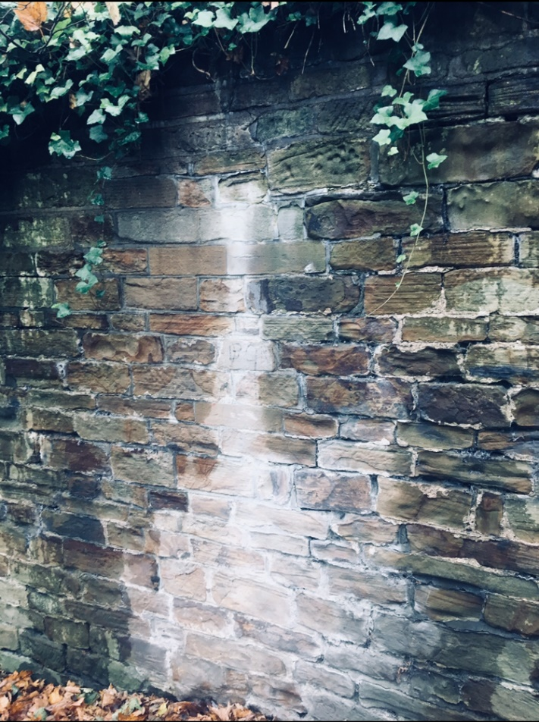
Lived experience for siblings
“…this one was more about her being taken over...if I like correlate that to when she was becoming ill...sort of her just like losing her soul…I just felt like I was an observer…the wall was [sister] and I was just, me sort of having to watch it erode away.”
Notes:
This photo represents Samantha’s experience of her sibling as the ED grew in power. She was “taken over”, she was “losing her soul”, Samantha stood by as a helpless “observer” watching her sister “erode away”. In actual fact that sense of a growing inaccessibility, and separation between the sibling pairs was a prevalent theme for all three participants.

Slide 9
Lived experience for siblings
“…in a good mood [INT: ok], she would eat, [INT: yup] erm yeah, she’d be eating, she’d be really friendly I suppose, she’d be, yeah, I don’t really remember any good days, [Hannah: laughs].”
“…a normal bad day I suppose, she would not eat, she would just be horrible to everyone [INT: mmm], she’d just death stare everyone… yell at people, I don’t know, it was kind of like this horrible like, thunder cloud almost, it would be, around the house, she’d walk into the room and that would like set the mood.”
Notes:
After that initial onset phase of the illness, there were good days and there were bad days for siblings. Hannah’s own psychological state was dictated by her experience of her sibling, which created high levels of anxiety in her that she expressed solely at school through panic attacks. She chose to speak first of the good days, but Hannah laughed after realising that good days were rare, and in analysis I noted my own laughter in response and felt complicit in minimising her experience. Perversely, difficult days were easier to negotiate than the good days because set roles were being adhered to and they had a familiarity. Hannah explained that her sister’s unpredictability of mood left her feeling that she was “constantly walking on eggshells” on good days and bad.

Slide 10
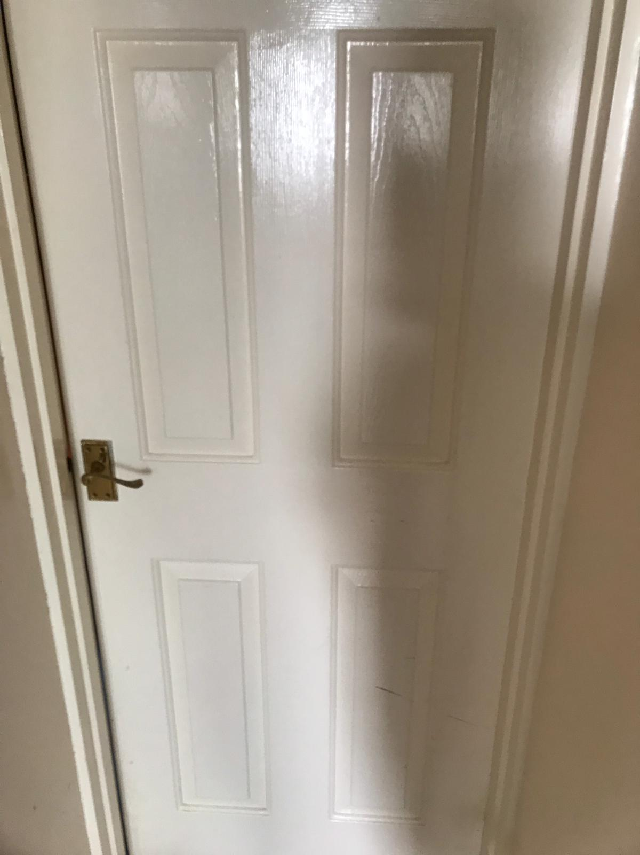
Lived experience for siblings
“…she’d just kind of lock herself away”
Notes:
All the siblings, at times, described the separation and isolation they felt the ED created in their relationship with their siblings. The physical barrier of a shut door or the geographical barrier of distance to an in-patient unit meant a destruction of relationships that in each case, have not yet been fully repaired. For Hannah, her experience of too many negative and unpredictable days led to her “emotional exhaustion” and led her to make what she described as a “half conscious, half subconscious” decision to self-protect. She explained further, “I can be nice, I can be a loving sister but I cannot, in a loving sister sense I cannot be loving and let her not eat - I can’t be that invested into her life.” And in research by Barak & Solomon they found that cognitive detachment by siblings was used to self-protect to enable siblings to focus on their own wellbeing. The participants’ shared complex stories and conflicting emotions and it made me realise that their lived experience is far more complex and messy than simply being able to shut off from the experience of the ED.

Slide 11
Experience and meaning of the power of the ED for siblings
“I am really not sure I did cope as such, I just sort of went through the motions of it, erm, and it became, I wasn’t, after the initial stages of understanding, I wasn’t confused. I think, the way I coped with it was just trying to, I suppose be quite resilient, and like, not let it faze me at all.”
“It was actually, looking back, really quite unhealthy. For two years I didn’t tell anybody, none of my like best friends. Literally nobody.”
Notes:
As part of the interviews we explored the ways in which the participants coped with their difficult circumstances. Coping strategies are often developed in the face of difficult circumstances and research shows that they become more entrenched in childhood (Kozlowska & Elliott, 2017). It is the adaptiveness of these learnt coping strategies into later life that can become problematic (Brennan et al, 2013). The participants coped in very different ways; through silence, through panic attacks at school, in the development of a rescuing role with others, by denial of self, withdrawal from the family or by numbing emotions. Hannah explained that she numbed her emotions because she didn’t want her sister to think her illness was having a negative effect on her. And when Samantha’s sister physically lashed out at her, she coped not by retaliation, Samantha’s only fear was of her sister collapsing. None of us know just how we would cope in that situation. Samantha here describes herself as resilient but in another extract talks of the massive emotional effect which remains unresolved. This speaks to me of the complexity of humanity, where seemingly incongruous characteristics such as resilience and vulnerability sit side by side As well as learning of ourselves in research, Boden found that we can often discern more of a participant than they can see for themselves.

Slide 12
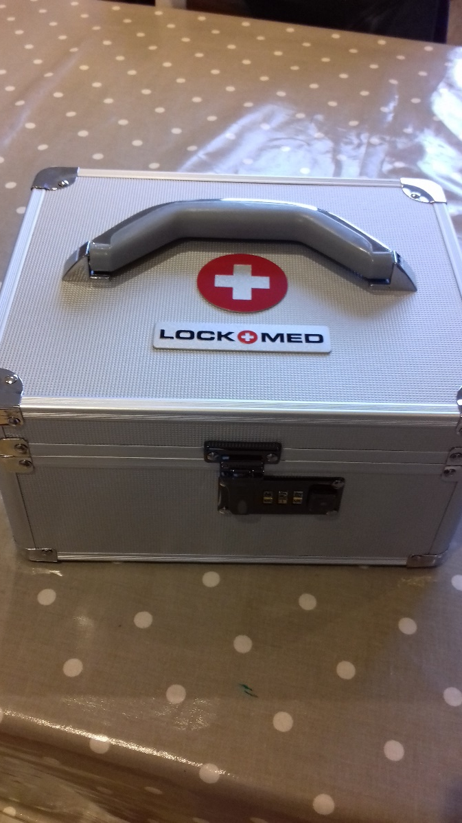
Experience and meaning of the power of the ED for siblings
“[sister] started self-harming, we had to lock all the kitchen knives away, [INT: ok] take all the medicines, put it in a locked box…anything to hurt herself with…. I think it was then that I realised how bad it was [INT: yeah]. I felt like, oh, this is good, we’ve got a lock box, now …I would be really protective over this box and I would go around finding little needles and pins.”
Notes:
Pause.
Not all coping strategies were maladaptive. Hannah developed a fierce protectiveness over her two brothers after witnessing her older sister’s treatment of them. Where she witnessed her sister’s poor decision making, she determined to consciously choose wisely. And Hannah explained in a photo that her family invested in a lock up box to try and manage her sister’s repeated self-harm and suicide attempts. Hannah would search for small items to go into the box…I remember batting away an image of a small child frantically obsessing over searching for tiny objects and questioned if that was a healthy response, but to Hannah that represented coping.

Slide 13
Experience and meaning of the power of the ED for siblings
“… she very much took home to this armchair we have…, she honestly just looked like a corpse…Erm, but yeah, then Isobel got ill and my brother carried Isobel out to the car, cos my mum was taking her back to hospital, erm, and I remember seeing Isobel like being carried, like, literally like a child into this car. And I honestly, like I did think like, I’m not going to see her again [INT: aww]”
“…and they would die, and so often I’d go back in a couple of days and like, their bedroom, like, their name would be gone [INT: oh goodness]”
Notes:
Pause.
An unexpected but really important theme was the potential for the sibling’s to die as a result of their ED. Death remains a taboo subject in ED literature but is an issue full of terror and horror for siblings. I recognised a cognitive and embodied feeling of distress at this point in this interview, and I worked hard to suppress the feeling, but needed to attend to it later. Boden et al. (2016) recognised that much of our emotion is held during interviews to resurface later, often weeks later, offering unexpected insight long after the interviews are finished. Samantha experienced a significant role reversal from the maternal figure her sister had represented. Here, she presents as the mother watching the small, frail child being carried out, possibly for the last time. The unbearable and incomprehensible potential loss for both siblings made me cry that evening following the interview. Allowing exploration of their pain that I’d internalised is recognized in reflexive texts as a useful tool (Boden et al., 2016).
And it was not just her sister’s fragility that affected Samantha but also the images that confronted her in in-patient care where she visited her sister for two years. Having described the patients as skeletons wheeling themselves around in wheelchairs, too sick to walk, Samantha said “…and they would die, and so often I’d go back in a couple of days and like, their bedroom, like, their name would be gone”.
I was conscious of a rising hysteria in me during the interview that threatened my ability to be professional. I felt there was incomprehensible horror that death had become so commonplace that names were simply removed. It connected me back to Samantha’s early use of the word “erase” to describe the extinguishing of her sister’s role in her life and there seemed a haunting link. And for Samantha and her family, their experience of names simply being removed kept her, and the family, constantly connected to the fear of death.

Slide 14
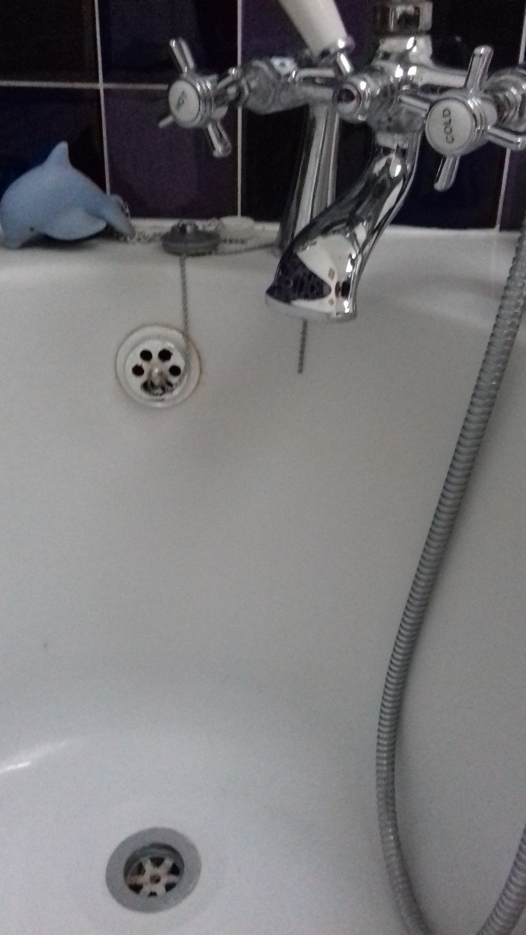
Experience and meaning of the power of the ED for siblings
“…she told me once that she did try and drown herself [INT: oh] by, by running herself a bath and forcing her head under the taps so she couldn’t get out again [INT: oh]…that has never left me, that has never left me at all”
Notes:
Pause.
For Hannah, her photographs represented her fear of death in a different way. The image and story of her sister’s attempt to drown herself is emotive. PhotoVoice is a powerful visual tool that enabled the participants to represent their stories in a creative way. Hannah’s image represented her sibling’s four suicide attempts; it was what she most wanted to tell me about and her distress was palpable. It made me realise that when left to direct their own stories, participants can share the richest and most significant information. Knowing this has encouraged me to be braver, less directive and to truly give voice to participants in future research because I am finding out that there’s an intersection between direction and creativity where magic seems to happen. Hannah repeatedly questioned why her sister had to share these details with her, I questioned why she felt such a strong desire to share with me and you may question why I’m showing you this photo? Is research cathartic, for participants, for the researcher, does it enable the traumatic to be sanitised, can we present the complexity and reality of life on paper?

Slide 15
The lived experience and meaning of sibling support
“I spoke a lot about it with them at the time. Yeah, and kind of what’s going on and how can I help, so I guess they were like helpful counsellors…”
“so I wanted my school life and social life to be normal. And people knowing would change that, including school”
“…it was horrific, absolutely horrific”
“I don’t think we got to the bottom of anything”
“so, it’s kind of like, get pushed to the bottom of the pile, so in like, in CAMHS or something I don’t know if they see it as important, probably not…”
Notes:
The secondary aim of my research was to discover the formal and informal support that the participants had been able to access and how their lived experience of support corelated with what they felt they had needed. Whilst the most obvious source of support is parental, an ED often compromises parent’s ability to care for siblings and for two of my participants they were in single parent families. Support ranged from a helpful experience with both parents to a web of silence (McKeever, 1983) which for Samantha was coupled with fear of stigma that meant she couldn’t access help either inside or outside of the home. The young people had varying experiences of more formal support through family therapy, and Samantha described her one session of family therapy as horrific. Hannah’s three sessions were a little better but were not consistent or sustained. She knew that CAMHS would not prioritise her case despite high levels of anxiety and repeated panic attacks, negating this as an option for her. Research shows that in the place of formal provision, adolescent friendships can be instrumental in providing support and in building resilience in the face of difficulty, but neither Clarence nor Samantha spoke with friends and Hannah confided only in one close friend. Stigma silences which negates the ability to receive support.

Slide 16
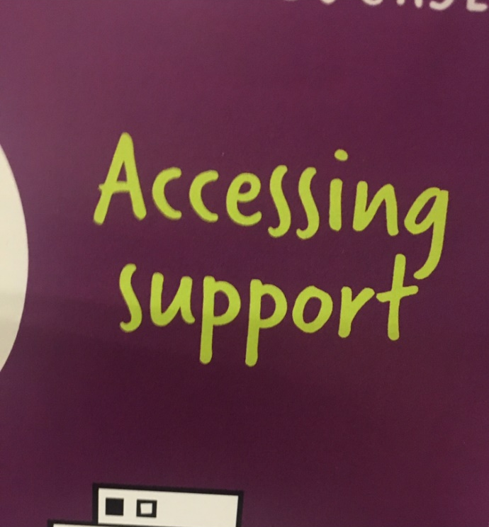
The lived experience and meaning of sibling support
“…accessing support, I think sends out a message that it’s easily accessible and also that it’s like, like, that support it’s like, this phrase to me suggests that the person themselves should be seeking it.”
“…a space which is very safe to just ask questions and talk about what’s on your mind, because it’s all so bottled up and of course you don’t, there really isn’t anyone that you can ask those questions to.”
Notes:
Participants were well aware of the support they felt they should have had and were not afraid to express it. They were passionate about presenting their views, and they realise that it is too late for them but they want to champion the cause for those in similar situations which is why this research matters. I assured them that I would use their stories to try and create change in the system. There is currently no national protocol for sibling support where there is an ED diagnosis. This highlights the urgent need for discussions about support with the hope that it might result in increased training for professionals and GP’s so that a holistic family needs assessment becomes routine. The support that participants longed for were help with verbally communicating their feelings of distress, to be given permission to continue hobbies of their own without feeling guilty, to meet with others going through the same experiences as them, to have information and education about their sibling’s ED so they no longer wondered if they were being sedated, force fed or restrained, they were desperate for high quality and timely support from professionals, and they wanted space, just space and time to ask questions.
Latzer, Katz and Berger (2015, p.641) summarise the importance of a comprehensive framework of support for siblings, saying “It is recommended that the therapeutic process place the sibling dyad in the centre…By dealing with these issues in the difficult process of coping with the illness, the supportive strength of the sibling subsystem may be restored.”

Slide 17
And to the future…
PhD on adolescent suicide attempts and communication of intent
Two papers on MSc research co-authored with my supervisor
Continued interest and potentially further research into Eating Disorders
A desire to continue to represent participant’s views where possible
If you have questions or thoughts or comments...
Laurahrpatterson@gmail.com
Twitter: @laurahrp
Notes:
And finally, to the future. For me it involves speaking at more conferences and presenting a PhotoVoice exhibition of all the participant’s photos and extracts. I’ve written up my research in a paper with my supervisor that I will submit to a journal for publication. There are many more articles to be written from the dataset too. I’m hoping to go on to do a PhD, not in eating disorders but around communication within relational networks prior to a suicide attempt. For my participants, they have relationships to repair after the damage of the ED and their own traumatic memories to work through. Please do now ask me questions if you’d like to.

Slide 18
References
Boden, Z., Gibson, S., Owen, G., & Benson, O. (2016). Feelings and intersubjectivity in qualitative suicide research. Qualitative Health Research, 26(8), 1078-1090.
Burkitt, I. (2012). Emotional Reflexivity: Feeling, Emotion and Imagination in Reflexive Dialogues. Sociology, 46(3), 458-472.
Dimitropoulos, G., Klopfer, K., Lazar, L., & Schacter, R. (2009). Caring for a sibling with anorexia nervosa: A qualitative study. European eating disorders Review, 17(5), 350-365.
Etherington, K. (2017). Personal experience and critical reflexivity in counselling and psychotherapy research. Counselling and Psychotherapy Research, 17(2), 85-94.
Finlay, L., & Gough, B. (2003). Reflexivity: A practical guide for researchers in health and social sciences. Oxford: Blackwell Science.
Finlay, L. (2008). A Dance between the reduction and reflexivity: Explicating the "Phenomenological Psychological Attitude". Journal of Phenomenological Psychology, 39(1), 1-32.
Finlay, L. (2011). Phenomenology for therapists - Researching the lived world. Chichester: Wiley.
Jones, J. (2015). The contested terrain of focus groups, lived experience, and qualitative research traditions. Journal of Obstetric, Gynecologic & Neonatal Nursing, 44(5), pp.565-566.
Latzer, Y., Katz, R., & Berger, K. (2015). Psychological distress among sisters of young females with eating disorders. Journal of Family Issues, 36(5), 626-646.

Slide 19
References (cont.)
Letherby, G. (2003). Feminist Research in Theory and Practice. Maidenhead: McGraw-Hill International (UK).
Limbers, C., & Skipper, S. (2014). Health-related quality of life measurement in siblings of children with physical chronic illness: A systematic review. Families, Systems, & Health, 32(4), 408-415.
Nykiforuk, C., Vallianatos, H., & Nieuwendyk, L. (2011). Photovoice as a method for revealing community perceptions of the built and social environment. International Journal of Qualitative Methods, 10(2), 103-124.
Punch, S. (2005). The Generationing of Power: A comparison of child-parent and sibling relations in scotland’, Sociological Studies of Children and Youth, 10, 169-188.
Punch, S. (2008). You can do nasty things to your brothers and sisters without a reason: Siblings' backstage behaviour. Children & Society, 22(5), 333-344.
Punch, S. (2017). Negotiating sibling relationships and birth order hierarchies. Families, Intergenerationality, and Peer Group Relations, 5, 1-21.
Sharpe, D., & Rossiter, L. (2002). Siblings of children with a chronic illness: A meta-analysis. Journal of Pediatric Psychology, 27(8), 699-710.
Shinebourne, P. (2011). The theoretical underpinnings of Interpretative Phenomenological Analysis (IPA). Existential Analysis, 22(1), 16.
Smith, J., Flowers, Paul, & Larkin, Michael. (2009). Interpretative phenomenological analysis: Theory, method and research. London: SAGE.
Wang, C. (1999). PhotoVoice: A participatory action research strategy applied to women’s health. Journal of Women’s Health 8(2): 185-192.

