Slide 1
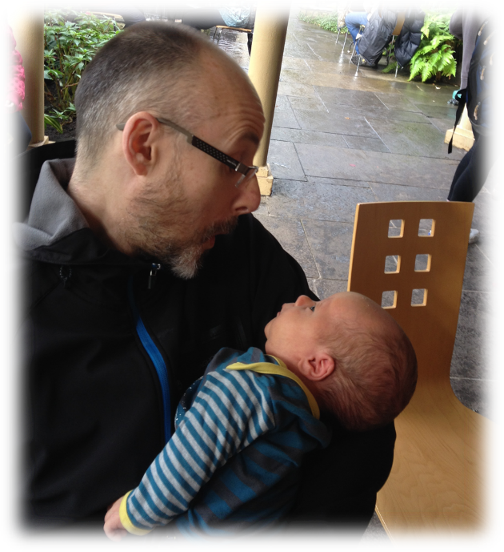
Development of an accessible relationship observation system for practitioners working with young families: The Child And Adult Observation (CARO)
Dr Lucy Thompson
Dr Christine Puckering

Slide 2
Why use systematic observation?
Children of mothers with perinatal mental health problems have an increased risk of long term adverse consequences. It is likely that parent-child interaction is the proximal route of transmission.
Very easy to be subjective and see only the positives or only the negatives, while usually there are strengths and difficulties.
Good basis for strengths-based video feedback, identified by Bakermans Kranenburg et al (2003) as a characteristic of effective interventions to enhance sensitivity in infant mental health programmes.

Slide 3
Development of MPOS
The Mellow Parenting Observation System was developed from research and practice to pick up a wide range of parent-child interactions demonstrated to be of importance for children’s longer term outcomes, including warmth and sensitivity and the management of children’s emotional and behavioural states

Slide 4
How it looks
Interactive behaviours were subdivided into 6 dimensions
  Anticipation
  Autonomy
  Responsiveness
  Cooperation
  Management of distress
  Control

Slide 5
How it looks
Each dimension is scored on a count of behaviours (key event scoring)
Factor analysis demonstrated that positive and negative behaviours are independent so it is possible to be
  High positive and high negative – hectic and unpredictable
  High positive and low negative – warmly engaged
  Low positive and high negative – hostile
  Low positive and low negative - unengaged

Slide 6
Positive anticipation
Video

Slide 7
Rough handling – negative responsiveness
video

Slide 8
Good autonomy
Video

Slide 9
Validity of MPOS
MPOS picks up therapeutic change between mothers with babies under a year during a Mellow Babies interventions
This was in line with a reduction in Edinburgh Postnatal Depression Scale scores

Slide 10
Total count of positive interactions before and after Mellow Babies group

Slide 11
Negative Interaction before and after Mellow Babies and Waiting list controls

Slide 12
From ALSPAC study
Children in Focus subgroup were video recorded looking at a photograph album with mothers (mainly)
60 children were identified at age 7 as having emotional and behavioural disorders
60 videos of these children and 120 of randomly chosen children were analysed blind to status
An average of 6.2 positive interactions per minute

Slide 13
From the ALSPAC study
One additional positive interaction per minute led to a 15% decrease in later disorders (95% CI: 4% to 26%)
One fewer positive interactions per minute led to a 15% increase in later disorders (95% CI: 4% to 26%)

Slide 14
Problems of MPOS
Time consuming to learn the system
Tough to become reliable with established coders

Slide 15

CARO – testing it out in ‘real life’
Image: www.online.colostate.edu/global/images/degrees/masters-social-work-colorado_1200.jpg
Dr Lucy Thompson PhD MBPsS
Senior Research Fellow
Centre for Rural Health

Slide 16
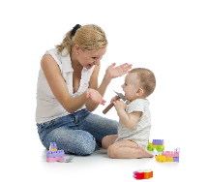
Rationale
Clinicians already use their professional experience to assess the quality of a parent’s relationship with their child
But this is usually informally recorded (if at all) and very dependent on a practitioner’s experience
The use of a shared, structured, evidence-based method may mean that:
  concerns can be more clearly articulated to families, colleagues and other agencies
  and developing problems are addressed more appropriately and at an earlier stage

Slide 17
Comparing MPOS to CARO

Slide 18
Comparing MPOS to CARO

Slide 19
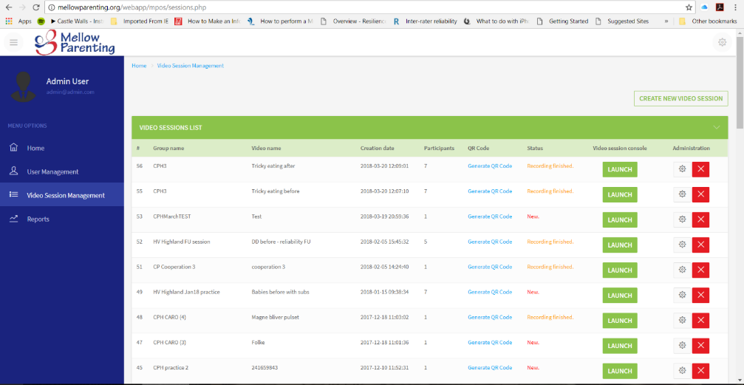
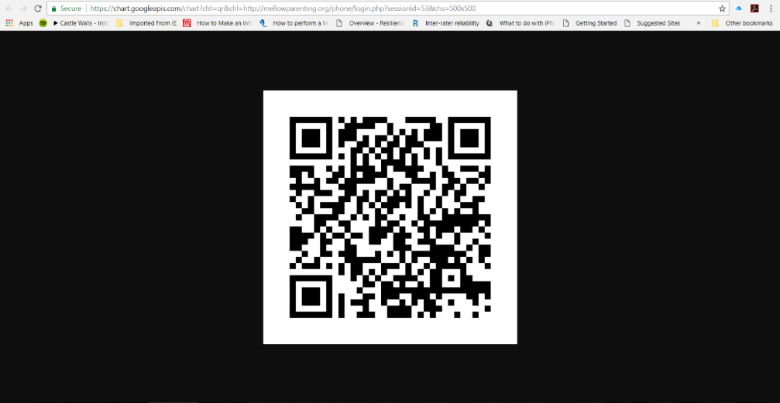
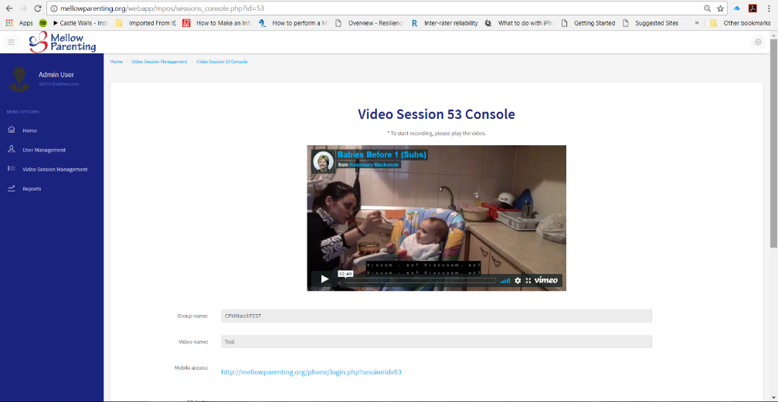

Using the online app

Slide 20

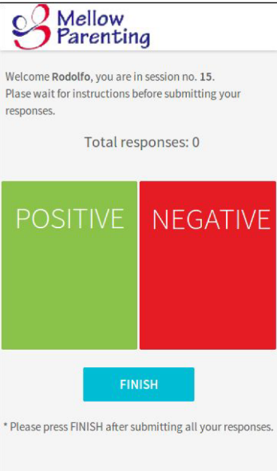

Using the online app

Slide 21
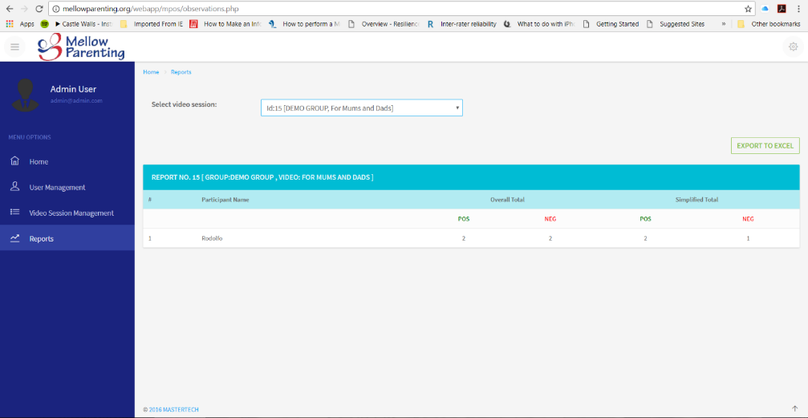
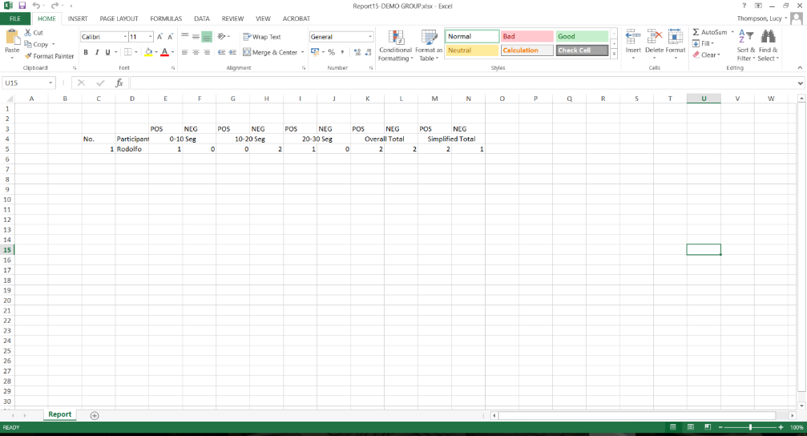
Using the online app

Slide 22
Support for CARO
One HV had used the observation system as a checklist in assessing a mother / toddler relationship. She reported that the system provides a language that strengthens the evidence for making a referral to another agency. In this case using the system facilitated a successful referral to psychological services.
HVs would like to see more of this sort of training as standard. Since the implementation of Getting It Right For Every Child (GIRFEC) , there is less focus on child development or infant mental health in training.
Recent implementation of Solihill training is welcome, but HVs felt that CARO is easier to apply in everyday practice.

Slide 23
Perceived barriers to implementing CARO
We need to think about how to approach the issue of security and trust around videoing interactions. What device is used? Who then owns the video material? How do we reassure parents re. confidentiality?
HVs need to be using it / practicing it regularly to stay skilled.
The reality is that HVs don’t have the capacity (time-wise) to be making and coding videos. Can we make this more of a real-time rating?
A quick-reference guide, such as a laminated A5 card showing a checklist, would be useful. (This would be similar to other documents HVs routinely carry and refer to.)

Slide 24
Reliability
As well as work being done with Scottish health visitors, trialling CARO as part of child health checks with Danish GPs
So far we seem to have fairly good inter-rater reliability for positive ratings after brief training, but not so good for negative ratings yet

Slide 25
Progress in Copenhagen
Time segment |  | positive |  |  |  | negative
 | Rater | 4 | 6 | 8 | CP | 4 | 6 | 8 | CP
 | 10 | 0 | 0 | 0 | 0 | 0 | 1 | 1 | 1
 | 20 | 0 | 1 | 1 | 1 | 1 | 1 | 0 | 1
 | 30 | 0 | 0 | 0 | 0 | 0 | 1 | 0 | 1
 | 40 | 0 | 0 | 0 | 0 | 0 | 1 | 0 | 0
 | 50 | 0 | 0 | 0 | 1 | 0 | 0 | 0 | 1
 | 60 | 0 | 0 | 0 | 0 | 1 | 0 | 0 | 1
 | 70 | 0 | 0 | 0 | 0 | 0 | 1 | 1 | 1
 | 80 | 0 | 0 | 0 | 0 | 1 | 1 | 0 | 1
 | 90 | 0 | 0 | 0 | 0 | 0 | 0 | 0 | 1
 | 100 | 1 | 0 | 0 | 0 | 0 | 1 | 0 | 1
 | 110 | 0 | 0 | 0 | 0 | 1 | 1 | 1 | 1
 | 120 | 0 | 0 | 0 | 0 | 0 | 1 | 0 | 0
 | 130 | 0 | 0 | 0 | 0 | 0 | 1 | 0 | 1
 | 140 | 0 | 0 | 0 | 0 | 0 | 0 | 0 | 0
 | Total | 1 | 1 | 1 | 2 | 4 | 10 | 3 | 11
Time segment |  | positive |  |  |  | negative
 | Rater | 1 | 2 | 3 | CP | 1 | 2 | 3 | CP
 | 10 | 1 | 1 | 1 | 1 | 0 | 0 | 0 | 0
 | 20 | 1 | 1 | 1 | 1 | 0 | 0 | 0 | 0
 | 30 | 1 | 1 | 1 | 1 | 0 | 0 | 0 | 0
 | 40 | 1 | 1 | 1 | 1 | 0 | 0 | 0 | 0
 | 50 | 1 | 1 | 1 | 1 | 0 | 0 | 0 | 0
 | 60 | 1 | 1 | 1 | 1 | 0 | 0 | 0 | 0
 | 70 | 1 | 1 | 1 | 1 | 0 | 0 | 0 | 0
 | 80 | 1 | 1 | 1 | 1 | 0 | 0 | 0 | 0
 | 90 | 1 | 1 | 1 | 1 | 0 | 0 | 0 | 0
 | 100 | 1 | 1 | 1 | 1 | 0 | 0 | 0 | 0
 | 110 | 1 | 1 | 1 | 1 | 0 | 0 | 0 | 0
 | 120 | 1 | 1 | 1 | 1 | 0 | 0 | 0 | 0
 | 130 | 1 | 1 | 1 | 1 | 0 | 0 | 0 | 0
 | 140 | 1 | 1 | 1 | 1 | 0 | 0 | 0 | 0
 | 150 | 0 | 1 | 1 | 1 | 0 | 0 | 0 | 0
 | 160 | 1 | 1 | 1 | 1 | 0 | 0 | 0 | 0
 | 170 | 1 | 1 | 1 | 1 | 0 | 0 | 0 | 0
 | 180 | 0 | 1 | 1 | 1 | 0 | 0 | 0 | 0
 | 190 | 1 | 1 | 1 | 1 | 0 | 0 | 0 | 0
 | 200 | 1 | 1 | 1 | 1 | 0 | 0 | 0 | 0
 | Total | 18 | 20 | 20 | 20 | 0 | 0 | 0 | 0
Time segment |  | positive |  |  |  | negative
 | Rater | 1 | 2 | 3 | CP | 1 | 2 | 3 | CP
 | 10 | 1 | 1 | 1 | 1 | 0 | 0 | 0 | 0
 | 20 | 1 | 1 | 1 | 0 | 1 | 0 | 0 | 0
 | 30 | 0 | 1 | 1 | 1 | 0 | 0 | 0 | 0
 | 40 | 1 | 1 | 1 | 1 | 0 | 0 | 0 | 0
 | 50 | 1 | 1 | 1 | 0 | 1 | 0 | 0 | 1
 | 60 | 0 | 1 | 1 | 1 | 0 | 0 | 0 | 0
 | 70 | 0 | 1 | 1 | 1 | 1 | 0 | 0 | 0
 | 80 | 0 | 1 | 1 | 0 | 1 | 0 | 0 | 1
 | Total | 4 | 8 | 8 | 5 | 4 | 0 | 0 | 2
Homework 2
Post-training ratings
Homework 1

Slide 26

Next steps…
Conduct CARO on a large set of videos to ascertain concurrent (predictive?) validity
A new training session with a larger group of health visitors would be ideal – look at inter- and intra-rater reliability
Need to test out CARO on real clinical situations and see whether “triage” decisions:
  Become more “accurate” over time
  Are reasonably consistent across different clinicians
And we need to find out how much training might be appropriate
Continue refining the app

Slide 27
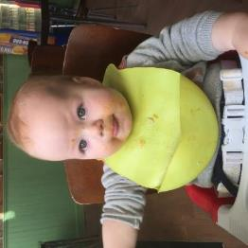


Thank you!
For more information:
Lucy.Thompson@abdn.ac.uk
cpuckering@mellowparenting.org

