Slide 1
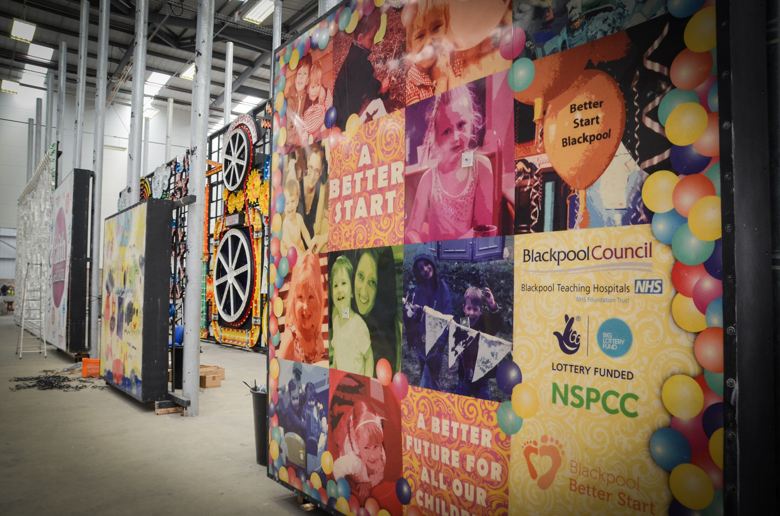


++
A Better Start Blackpool
Driving Change through a Trauma Informed Lens
&
Community
Co-Production
6th September 2019
Debra Davies
Sarah Gorst
Vicki Walker

Slide 2

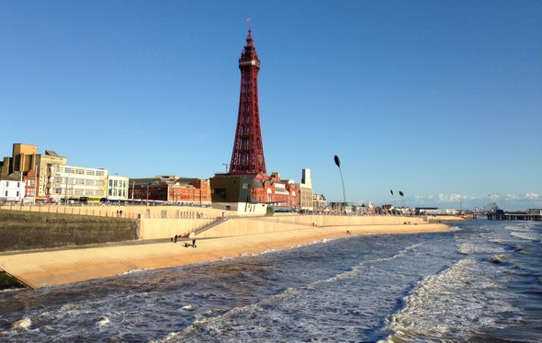
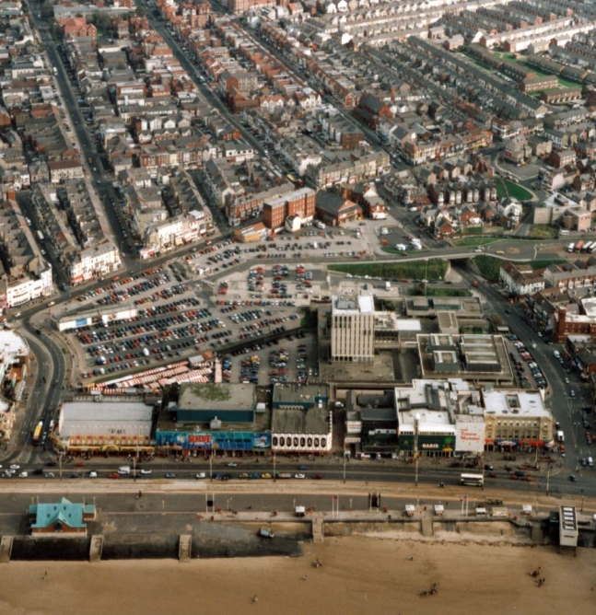
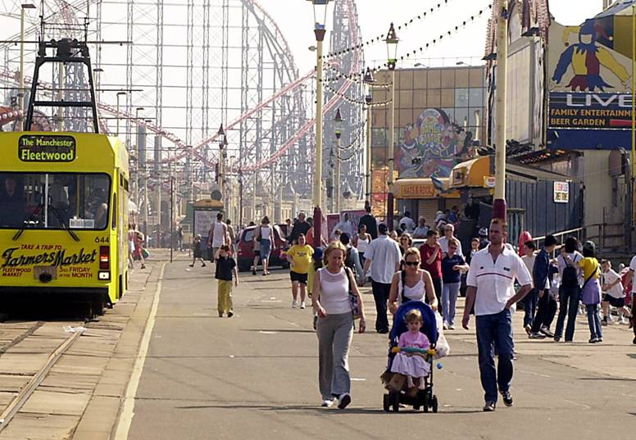

www.blackpoolbetterstart.org.uk

Slide 3
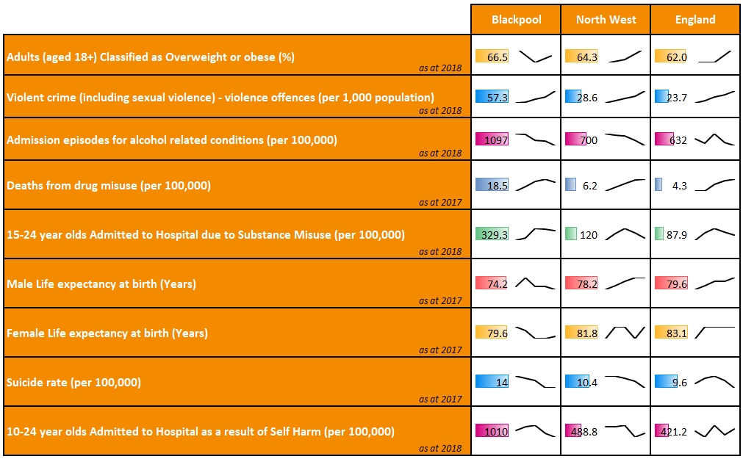
What is it like raising a family in Blackpool?

Slide 4
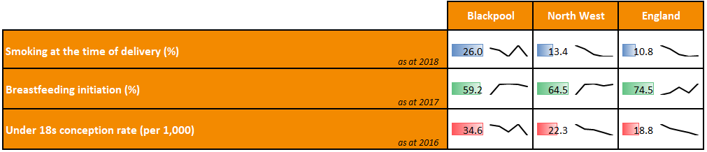

What we know about pregnant women!
What about Children’s Outcomes?

Slide 5

A Better Start
Breaking the cycle of intergenerational poor outcomes
www.blackpoolbetterstart.org.uk

Slide 6
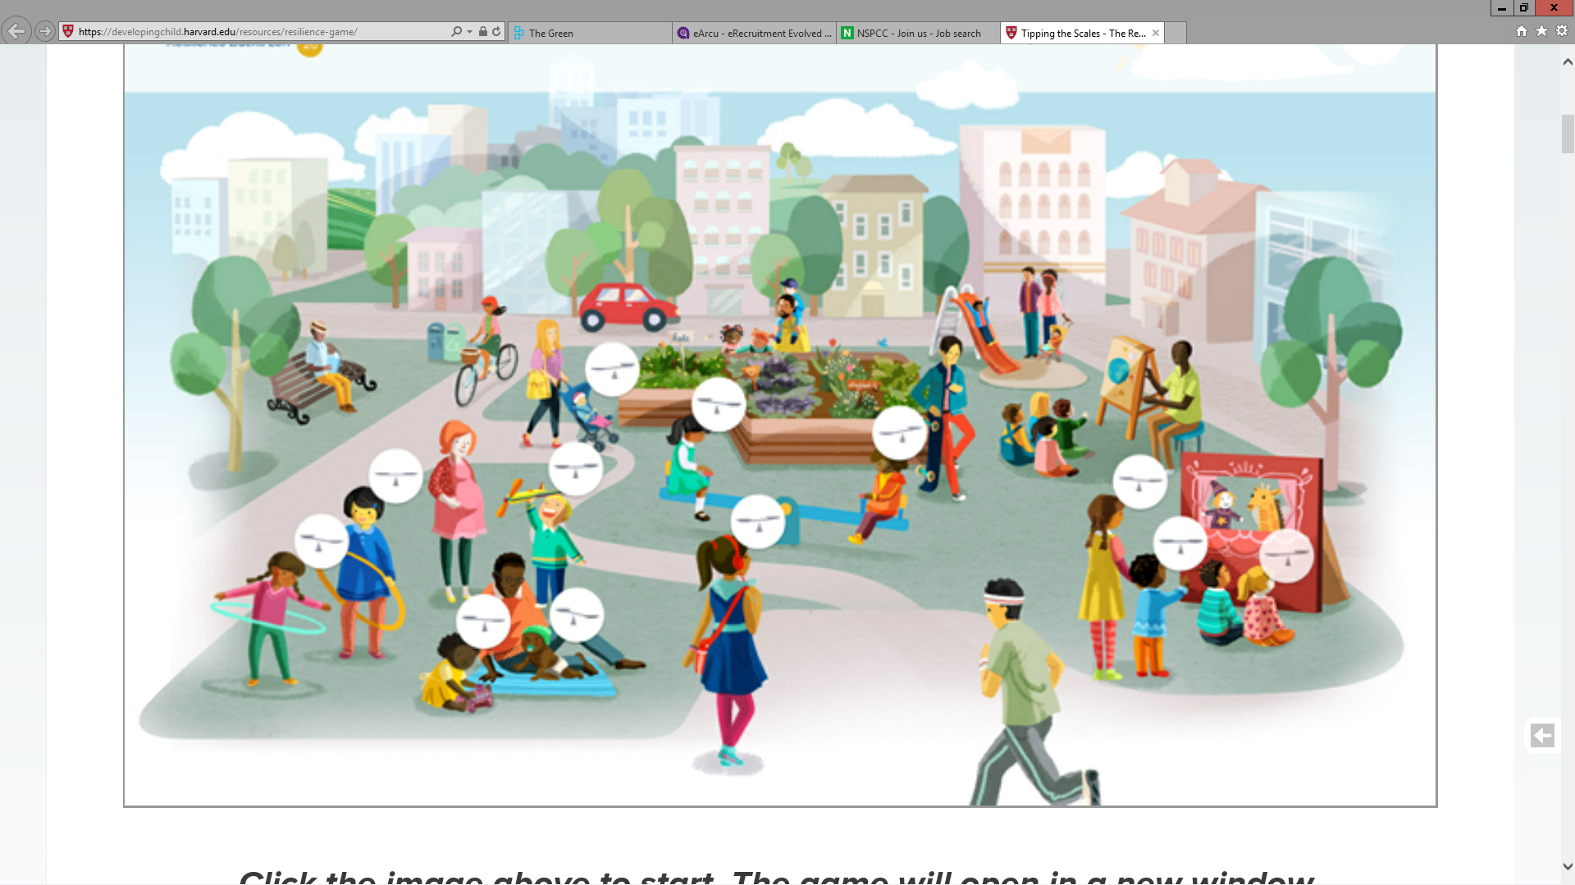
Blackpool Local Authority
NSPCC
NSPCC
Parents and Community
Police
Clinical Commissioning Group
Blackpool Hospital Trust
www.blackpoolbetterstart.org.uk

Slide 7


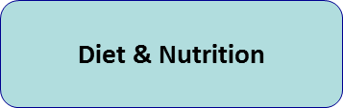



A Developmental Approach
www.blackpoolbetterstart.org.uk

Slide 8
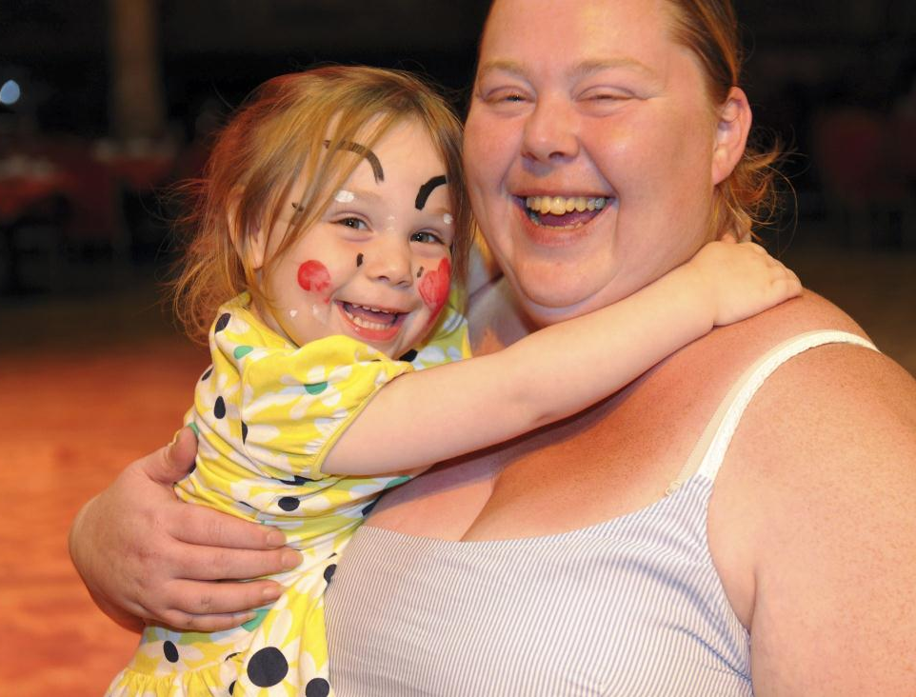
‘’Our pledge is……
…is to make a generational shift, ensuring today’s babies enjoy the early care and nurture they need for healthy development and to be ready for school. And that in turn, as they grow up and become parents themselves, they will pass on the Better Start legacy to the next generation”
A Better Start
A Better Future for the Children of Blackpool

Slide 9
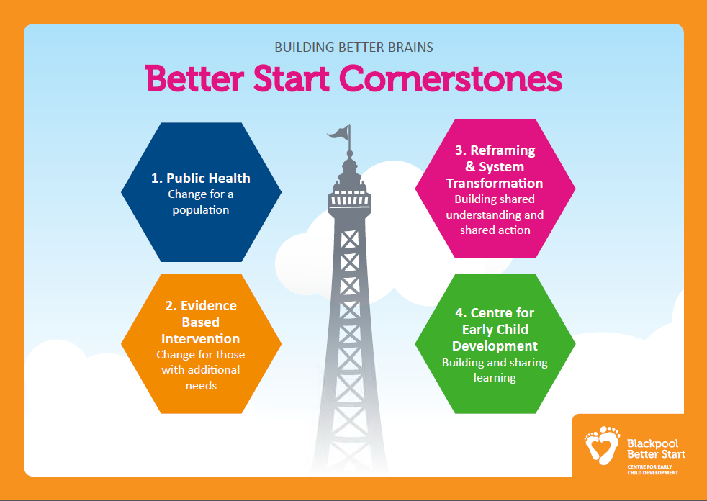
4 Cornerstones

Slide 10
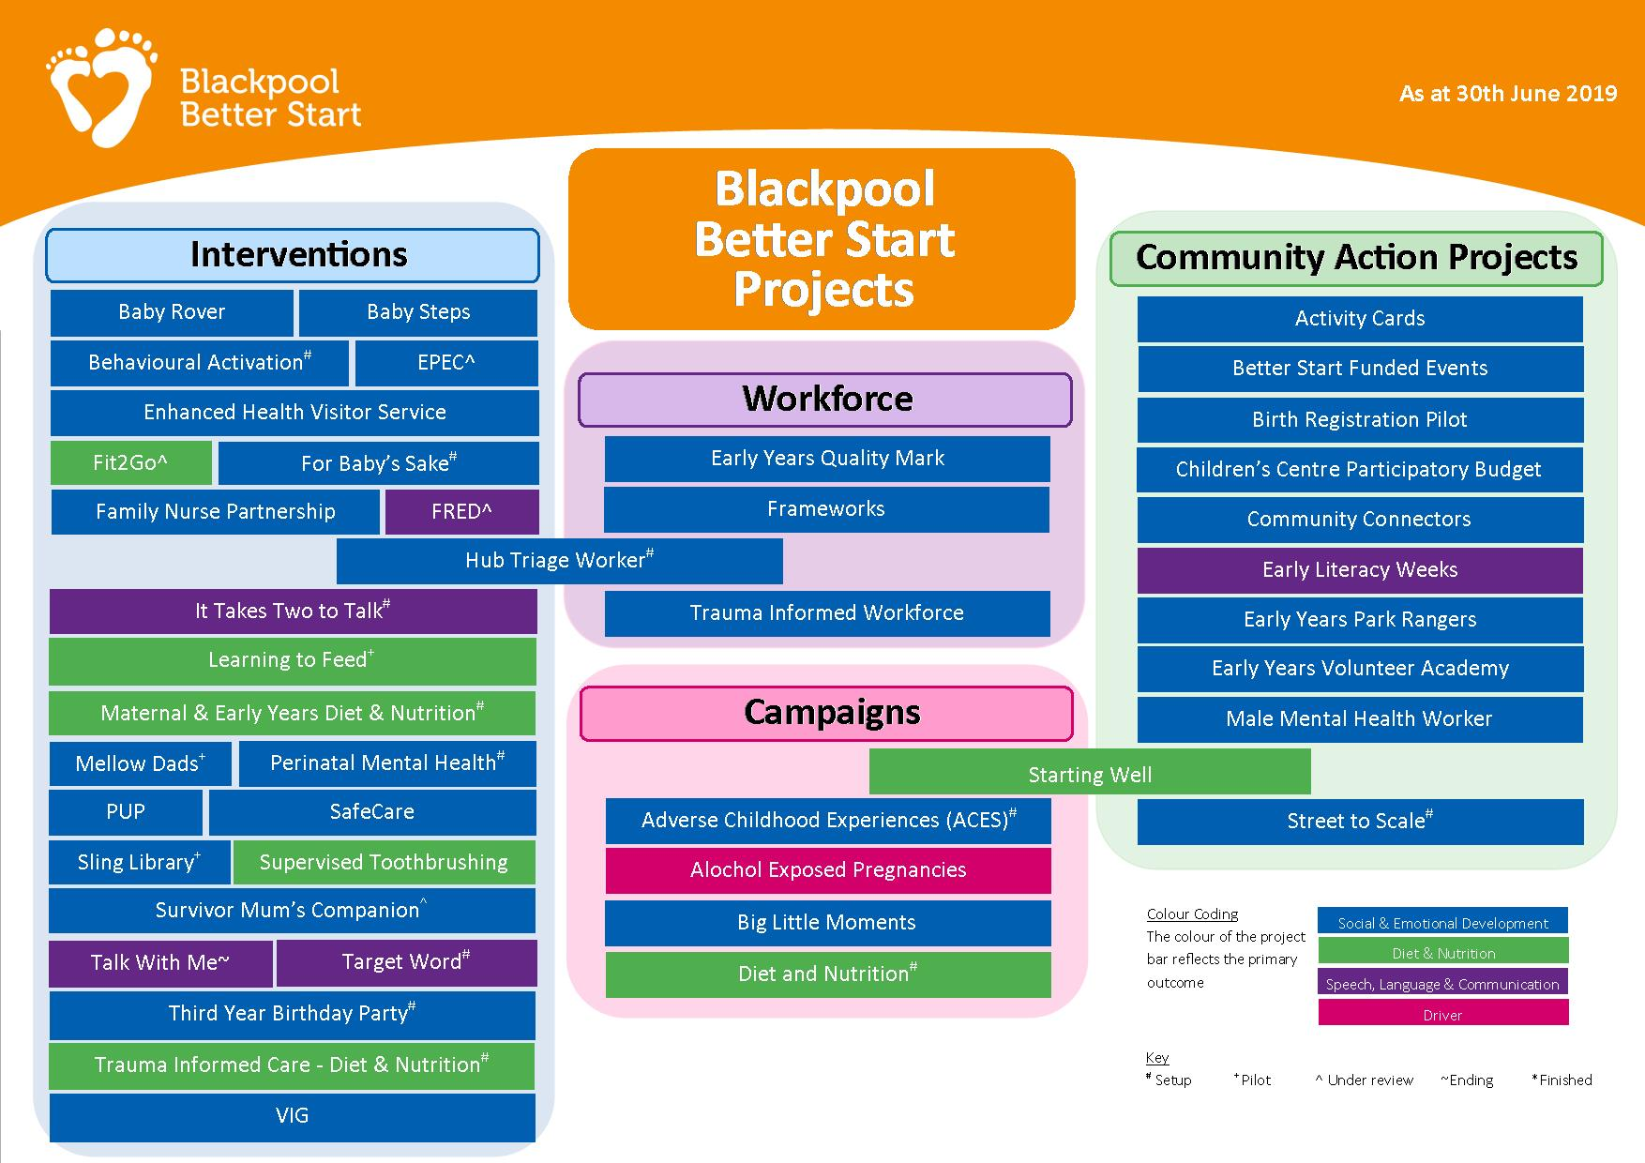

Slide 11
Community Engagement
&
Co Production
Supporting and enabling the community to achieve sustainable change
Community Voice
Training and volunteering opportunities
Parent Panels and Activity budgets
Community Connectors
www.blackpoolbetterstart.org.uk

Slide 12

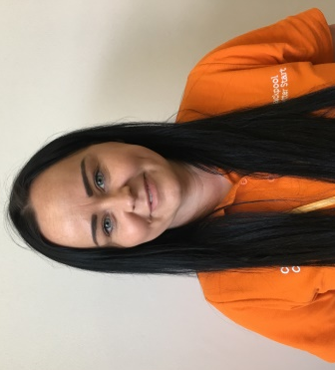
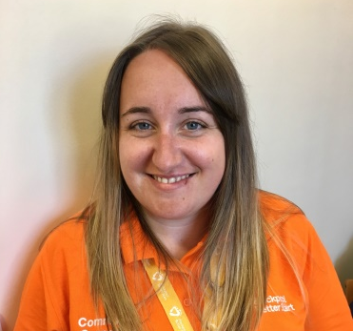
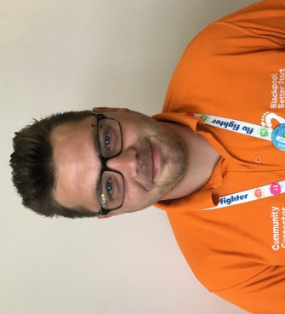
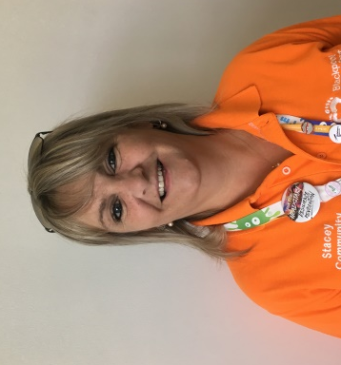
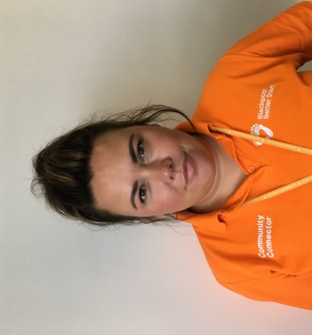
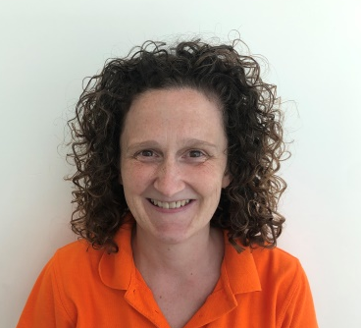
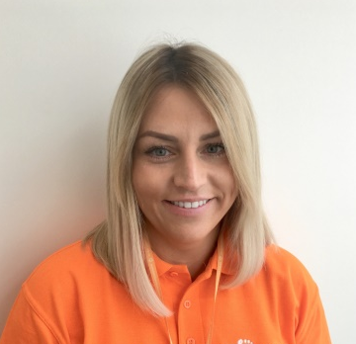
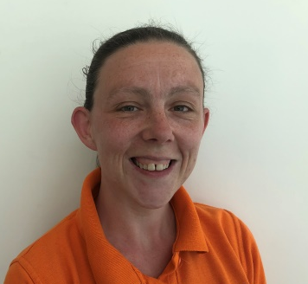
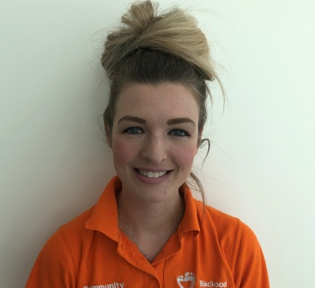
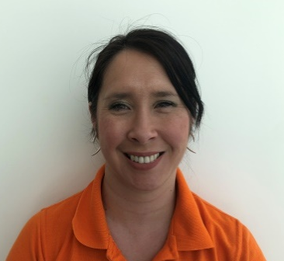
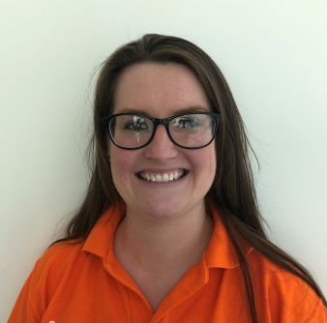
Meet our Connectors
Community Connectors
Gemma Howson
Community Connector
Mereside
Julie Ward
Community Connector
Westminster
Gary Cumber
Community Connector
Revoe
Stacey Baron
Community Connector
Grange Park
Community Health Connectors
Susan Gorst
Community Connector
Talbot & Brunswick
Katie Whale
Health Connector
Emma Hobbs
Health Connector
Jade Lord
Health Connector
Simone Moore
Health Connector
Jade Swain-Veneziale
Health Connector
Nichola Dawson
Health Connector
blackpoolbetterstart.org.uk/community-connectors

Slide 13
Health Connectors
Promote uptake and access to health related services and programmes
  Healthy Start vouchers and vitamins
  Accessing Speech and Language Service
  Accessing Oral Health services
  Learning to Feed
  Baby Steps
  Move Play & Grow
  Sling Libraries
www.blackpoolbetterstart.org.uk

Slide 14


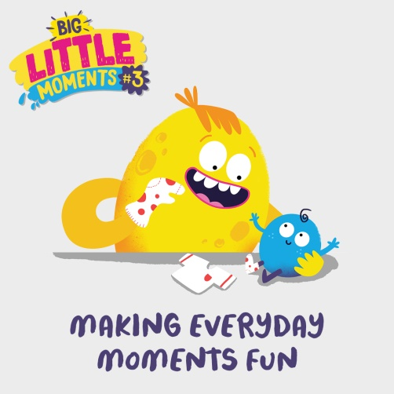
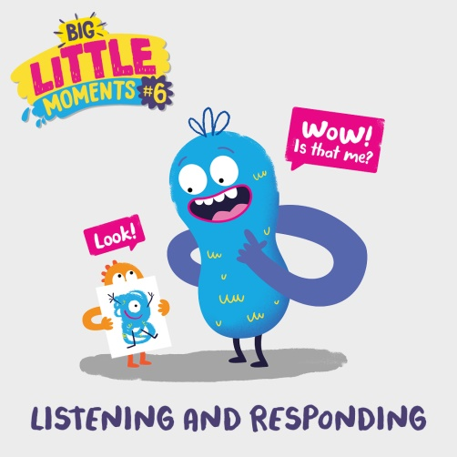
Big Little Moments
Social Emotional, Speech and Language Campaign
Developed with all 5 ABS sites and Frameworks
Based around the metaphors of Early Child Development of
    Serve and Return
    Brain Architecture
    Skills Rope
Campaign messages
Everyday activities can help your child to learn and grow
Babies and Children’s brains need building
Interactions with children everyday help them to develop
https://blackpoolbetterstart.org.uk/biglittlemoments/

Slide 15
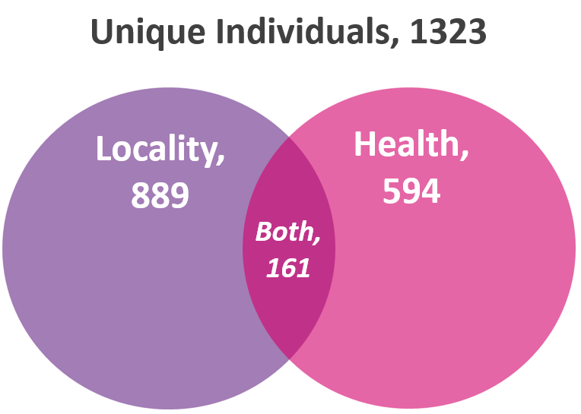
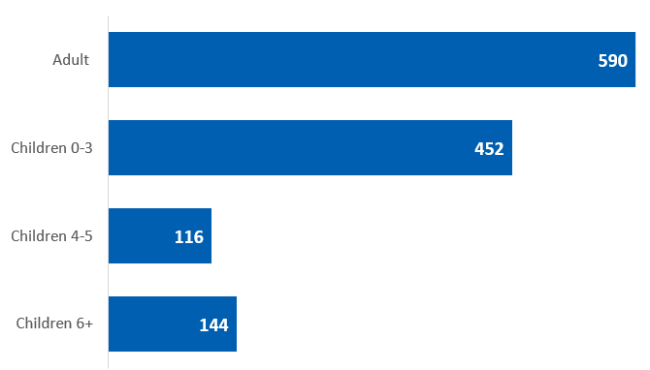
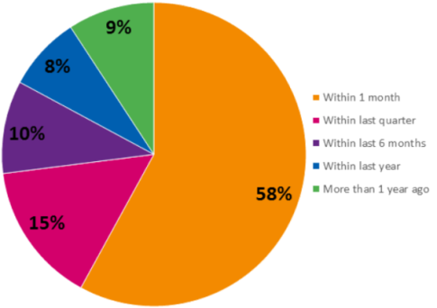
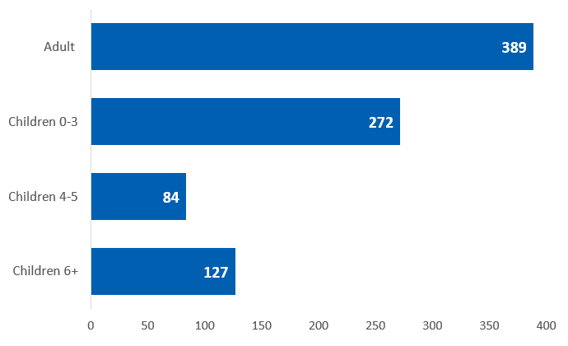
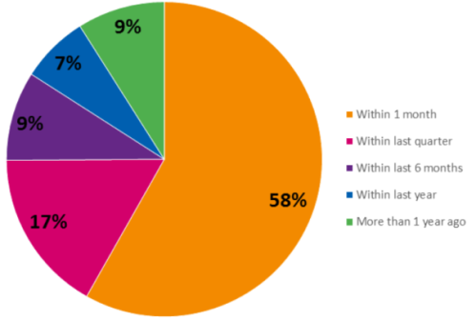
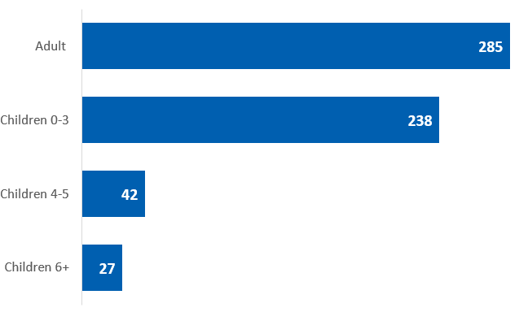
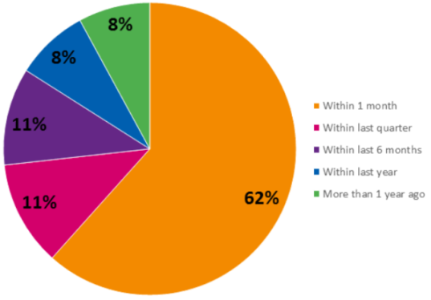
Community Connector Contacts 2018 – 2019
Total Community Connector Contacts
Unique Individual contacts | Maximum days difference 4122 | Length of time since last interaction with Children’s Centre
 | Average days difference 124
Locality Community Connector Contacts
Unique Individual contacts | Maximum days difference 4122 | Length of time since last interaction with Children’s Centre
 | Average days difference 127
Health Connector Contacts
Unique Individual contacts | Maximum days difference 1534 | Length of time since last interaction with Children’s Centre
 | Average days difference 99

Slide 16


Connectors and the Harvard Frontier of Innovation
KEY RESEARCH QUESTIONS
Do parents connect with the families and services they are pointed to?
Do these connections last over time?
Do parents better understand their needs and what their community offers them?
Do parents feel better connected, better supported and more confident ?
The Frontiers of Innovation (FOI) portfolio includes projects that are supported by FOI through ongoing consultation on the IDEAS Impact FrameworkTM, FOI’s approach to program development and evaluation.
CECD is First in UK
(30 projects across the United States, Brazil, Canada, Mexico, and the Netherlands)

Slide 17




Contacts
Debra.cecd@nspcc.org.uk
BetterStart.cecd@nspcc.org.uk
@debra_CECD
@CECDBlackpool

