Slide 1
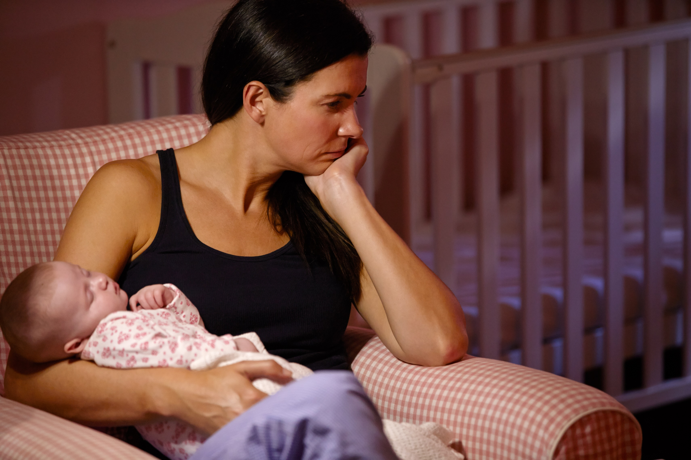
The Mellow Babies Trial: early process evaluation of a complex intervention
Dr Lucy Thompson Lucy Buchanan
Hope Christie Prof Philip Wilson
Centre for Rural Health
Institute of Applied Health Sciences

Slide 2
What is the study about?
Problems in children’s early social and emotional development are likely to have major long term consequences for them and for society more widely
Parental emotional well-being is a major contributing factor to a child’s social and emotional development
Previous research has shown that it is important to provide help and support when children are young, before problems grow and have knock-on effects for children’s learning and long term wellbeing.

Slide 3
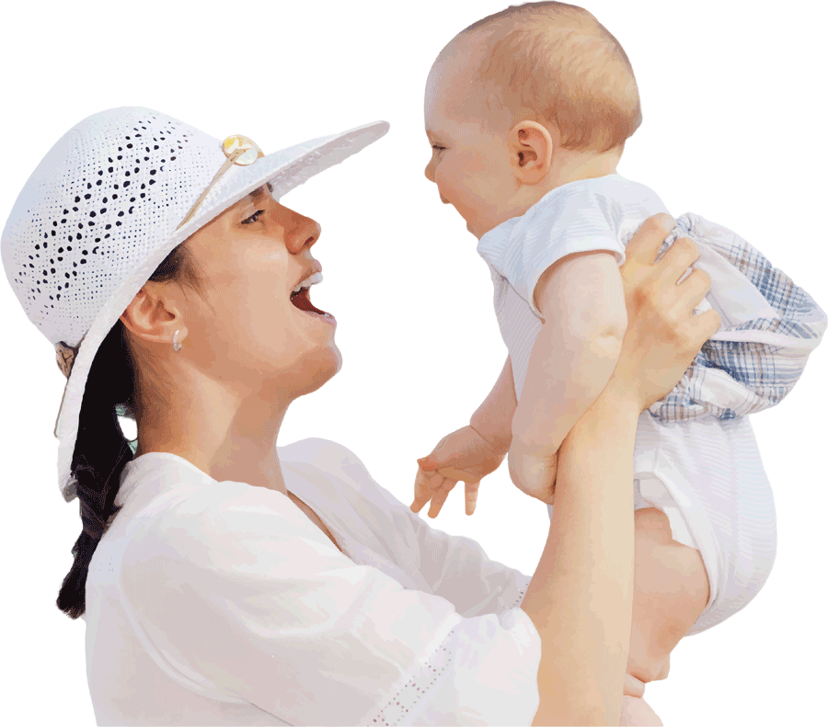
For each  of 1 positive interactive behaviour per minute at age 1 year…
…15%  chance of disruptive behaviour disorder at age 7 years
Puckering C, et al. (2014). BMC Pediatrics 14: 223.

Slide 4
Why are we doing this trial?
Mellow Babies is a group for parents who are struggling in their relationship with their baby
This study is designed to find out if attending a Mellow Babies group in addition to the normal care provided by health and social care services might help women and their babies
The research will help health and social care staff, for example health visitors, to offer the right kind of help for mothers and babies
Mellow Babies has been widely used nationally and internationally, and is well-liked. But there is yet to be a large randomised trial which demonstrating whether it really does make a difference

Slide 5
What will the study involve?
Population: mothers of babies aged 6-18 months, living in the Highland Council region, scoring >85th centile on anxiety and depression measure (HADS)
Sample: 212 mothers (in 2 years); aiming for full data on 170.
Design: 2 arm RCT – Mellow Babies + usual care vs. usual care only
Referrals: Health visitors, GPs, etc; self-referral
Internal pilot: 40 randomised & 2 groups established by the 30/11/19
Measures:
Baseline;
8 months post randomisation;
child reaches 30 months of age (incl. full assessment of child).
Process evaluation
Economic evaluation

Slide 6
Study set-up
Once we got the funding…
NHS ethical approval
NHS R&D approval
Trial registration
Meetings with referring practitioners
Training intervention practitioners
Establishing practicalities of intervention: venues, child care, transport, catering, etc
Start recruiting…

Slide 7
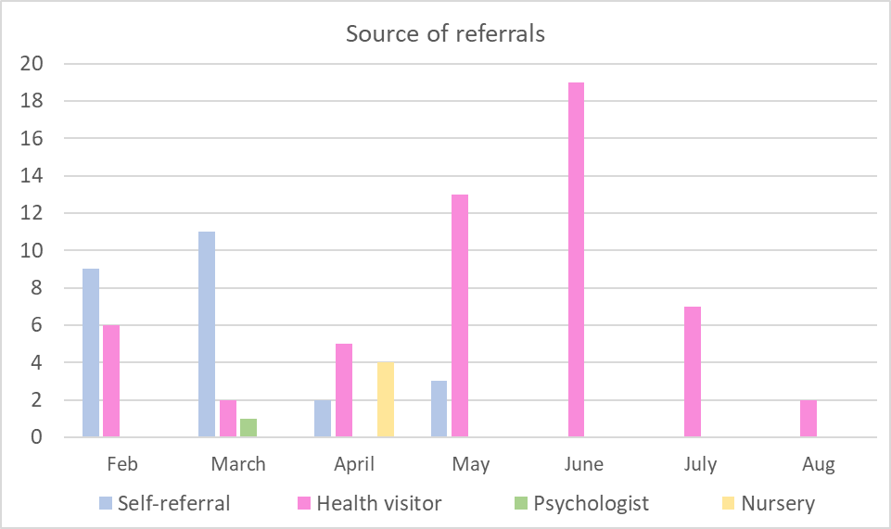

Slide 8
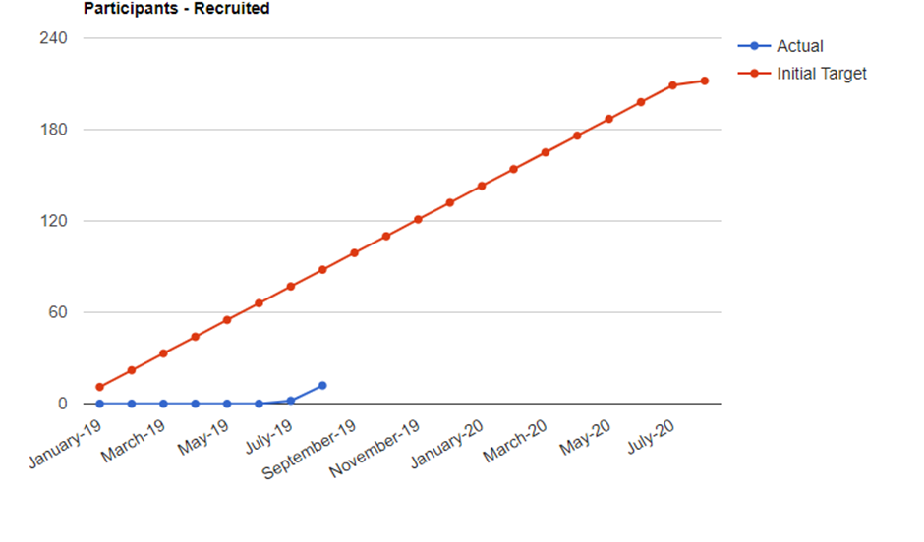

Slide 9
Interviews
Staff perspectives on recruitment gaining recognition
6 trial team members interviewed
‘Framework method’ for data analysis
Framework Method:
Interpret
Transcribe & code
Thematic indexes
Analytical framework
Summarise & synthesise
In this qualitative study, 6 individuals with experience working on the MBT were interviewed. Interviewee roles included principal and lead co-investigator, trial manager, trial research nurse and intervention co-ordinator.
Audio recorded, one-to-one interviews were conducted using a semi-structured topic guide, either in person or over telephone. Interviews lasted 45 minutes to 1 hour 45 minutes. Recordings were uploaded to a secure computer and transcribed by the researcher.
The ‘Framework Method’³ was used to analyse data. Transcripts were coded and thematically indexed. An analytical framework was created and applied to all transcripts. Themes were then identified across participant responses. Results were summarised, synthesised and finally interpreted.
Framework Method:
Interpret
Transcribe & code
Thematic indexes
Analytical framework
Summarise & synthesise
Framework Method:
Interpret
Transcribe & code
Thematic indexes
Analytical framework
Summarise & synthesise

Slide 10
Findings
Rurality of Highland
The Health Visitor
Communicating the message
The Trial Team
1.
2.
3.
4.

Slide 11
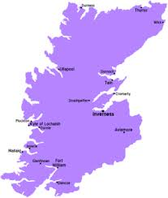
1. Rurality of Highland
Sparse geography & thinly spread populations
Lack of anonymity in small communities
‘Reserved’ culture in Highland
“You’re looking at needing a minimum of 24 people in a location or area. Well we’ve got things like 5 at Wick and 4 at Fort William.”
Trial Staff
https://wikitravel.org/en/Highland_(Scotland)

Slide 12
2. The Health Visitor
Lower referral numbers than anticipated
Cultural context of health visiting teams
Apprehensions: ethics & research detachment
“If HVs just don't see the value in it they think, “Why should I waste my time, energy, effort?” … If you’re not interested in research, you’re not going to see the importance of it.”
Trial Staff

Slide 13
3. Communicating the Message
Media uptake disappointing
HVs: consistency of message & overburdening of information
Mothers: from the right person & at the right level
“[The poster] is just too wordy, too academic… Very clinical. It’s not welcoming, it’s not cheery. Even the babies on it look miserable.”
Trial Staff

Slide 14
4. The Trial Team
Underlying tensions between teams
Contrast of research backgrounds and clinical backgrounds
Demoralising recruitment progression
“Short answer is terrible. Absolutely atrocious. Abysmal. We were… supposed to have 55 mums recruited by now and we're still sitting on zero.”
Trial Staff

Slide 15
Conclusions
Disappointing recruitment, typical of Lasagna’s Law
Potential impact of Patient & Public Involvement (PPI)
Stakeholders (e.g. HVs) in trial design
Social media can be effective in engaging potential participants

Slide 16
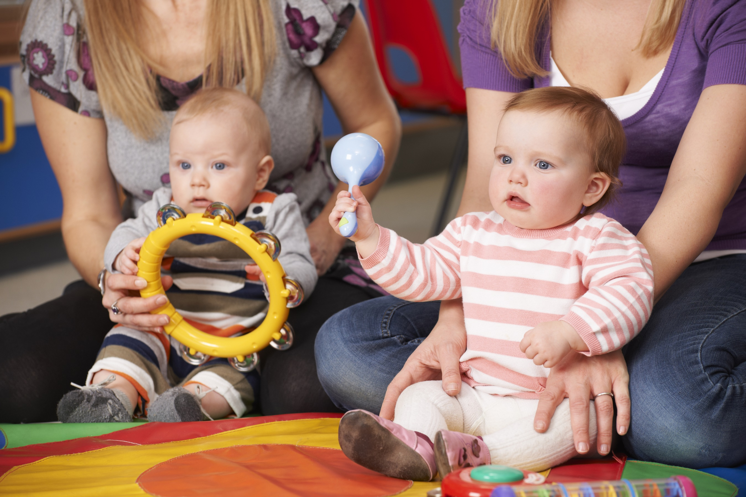
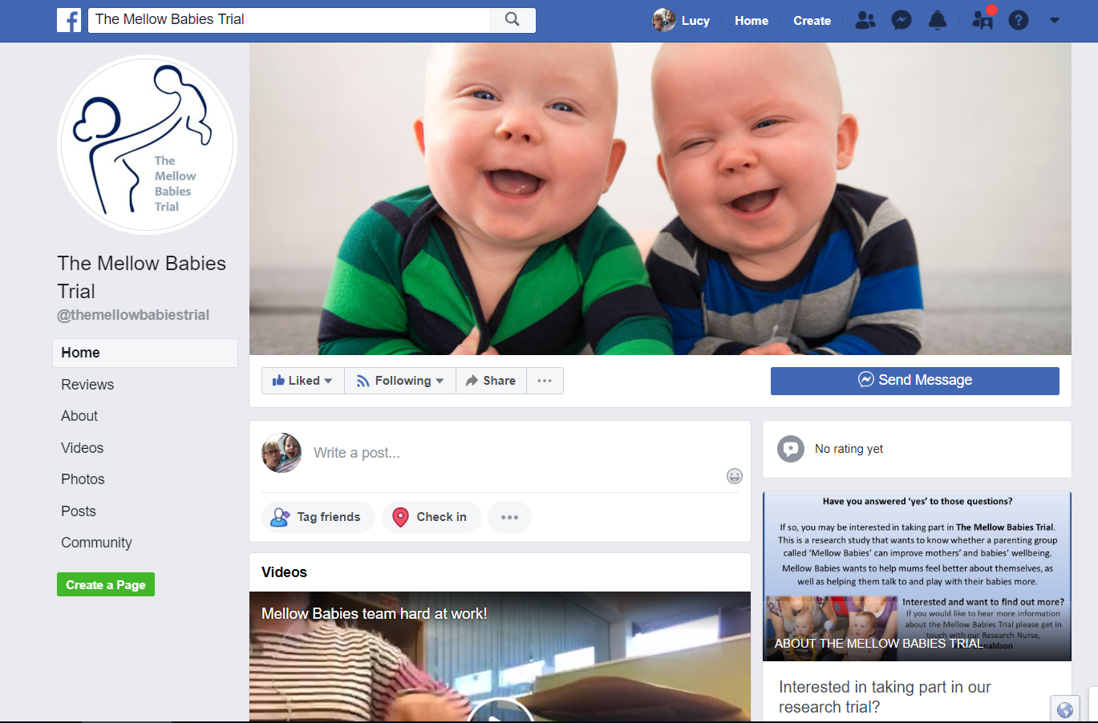
Thanks for listening
mellowbabies@abdn.ac.uk
w3.abdn.ac.uk/hsru/MellowBabies/
‘The Mellow Babies Trial’

