Slide 1
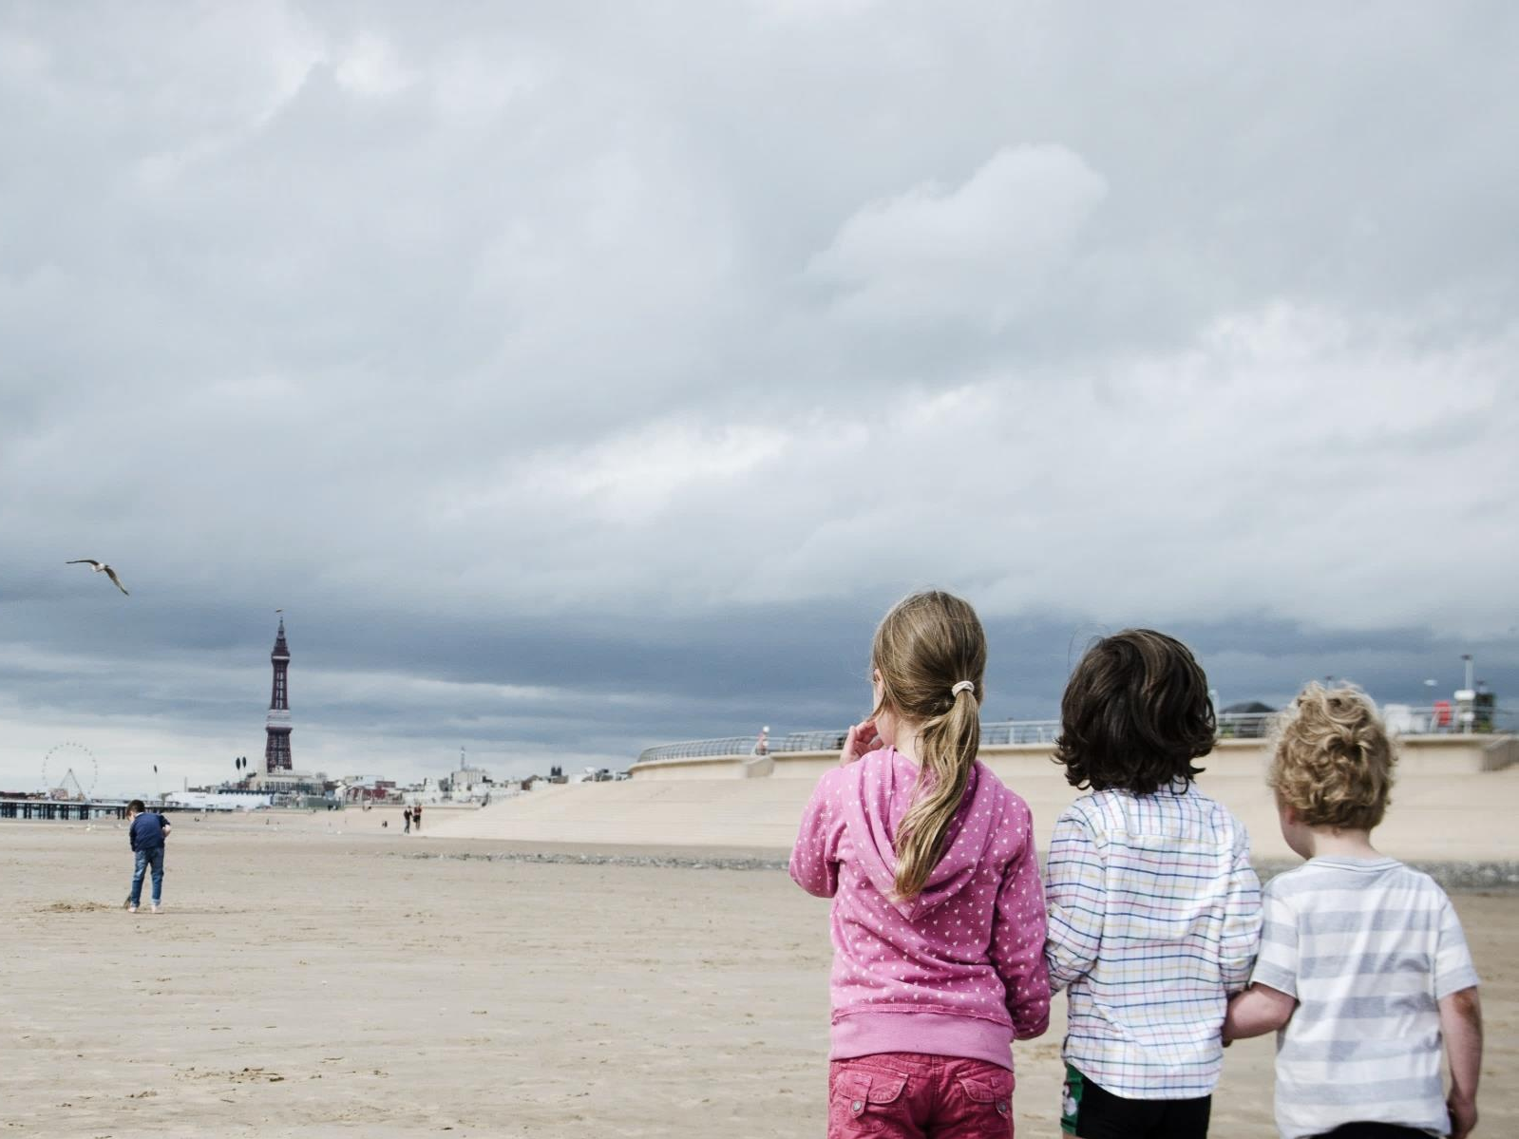
Evidence Based Trauma Informed Interventions
Sarah Gorst
@SarahG_CECD @CECDBlackpool
#itmatters

Slide 2
Overview
Trauma and ACEs
Evidence Based Programmes and strengths based approaches
Increasing awareness
#itmatters

Slide 3
The language of trauma and ACEs
How we talk about early experiences of trauma and adversity matters

Slide 4
What is Trauma?
Trauma is an event(s) that a person experiences or witnesses. It can be acute, complex, historical, secondary or intergenerational.
Financial Stressors
Domestic or Interpersonal Violence
Experience of Prejudice, Isolation or Discrimination
Relationship problems
Workplace or Employment Difficulties
ACEs: Physical, Emotional and Sexual Abuse
Own or Loved Ones Poor Health
ACEs: Household Dysfunction
ACEs: Emotional and Physical Neglect
#itmatters

Slide 5
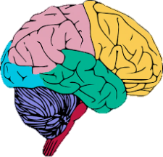
Impact of Trauma
2
7
Social & Emotional
Physical
Eating disorders
Sleep disturbances
Pain and low energy
Development of diseases
Respiratory conditions
Flashbacks
Depression, anxiety, panic attacks, and phobias
Poor anger management
Dissociation & numbness
Feelings of guilt & shame
Compromised parenting
Relationship problems
Behavioural
Self-harming
Addictions
Hypervigilant to stress
Self-destructive behaviours
Unhealthy relationships
Cognitive
Disrupted brain development
Poor memory functioning
Difficulty making decisions
Problems concentrating
Suicidal thoughts
#itmatters

Slide 6
Building Resilience
RESILIENCE
Concrete Support in Times of Need
Social Connections
Social and Emotional Competence
Knowledge of Parenting and Child Development
#itmatters

Slide 7
Our journey to becoming trauma informed
Systems Change
Evidence Based Programmes
Public Health Approaches
Community Development
Workforce Training
#itmatters

Slide 8
Maximising the impact of trauma focused interventions
01
02
03
04
Evidence based interventions
STRENGTHS AND RESILIENCE
relationships
Social support
Ensuring individuals are engaging in the right services. Often survivors engage with services due to their coping mehcanisms, not the trauma itself. Reducing critical stressors, increasing capabilities and understanding the impact of trauma is essential.
Positive relationships are key; they support and enable healing. Target mechanisms for trauma specific services tend to be in relation the emotional impact of the trauma eg improve affect regulation. Focusing the importance of relationships could also affect outcomes.
Increasing social support and ensuring individuals are connected into services is key to recovery and healing. Together we can decrease stigma and increase not only availability of services, but also their uptake. We must avoid the ‘hard to reach’ label.
Supporting people to do more of what they are good at and increasing self-efficacy. We must build resilience across the system and not just at an individual level. Increasing an individual’s resilience should not prevent organisations from doing things differently.

Slide 9
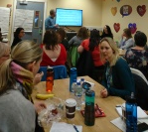
What We’re Doing…
Video Interaction Guidance
Baby Steps
Parents Under Pressure
Survivor Mum’s Companion
SafeCare
For Baby’s Sake
#itmatters

Slide 10
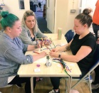
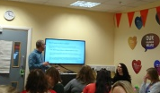
What We’re Doing…
Community Awareness
ACEs Health Visiting Enquiry
Community Voice
And CAPs
Behavioral Activation
ACE Police Briefings
Community & Health Connectors
#itmatters

Slide 11
What We’re Developing…
NHS England Contract
Psychological approach to maternal diet and nutrition
Trauma work with the Police
Children’s Services Workforce Training
#itmatters

Slide 12
Utilising a Trauma-Informed Approach
"What happened to you?" instead of "What's wrong with you?“
It is designed to avoid re-traumatising already traumatised people
It has a focus on "safety first" (including emotional
safety)
Includes a commitment to do no harm
#itmatters

Slide 13
Will you do things differently?
The ultimate goals of being trauma informed are to:
Prevent adverse outcomes
Support behaviour change
Help break intergenerational cycles
Change children’s lifespan trajectories
#itmatters

Slide 14
Thank you for taking part in this learning event today!
Contact us for more information:
Sarah - sarahg.cecd@nspcc.org.uk
#itmatters

