Slide 1
Learning to Feed Volunteer
Service
Victoria Walker
@Vicki_CECD @CECDBlackpool
#learningtofeed

Slide 2
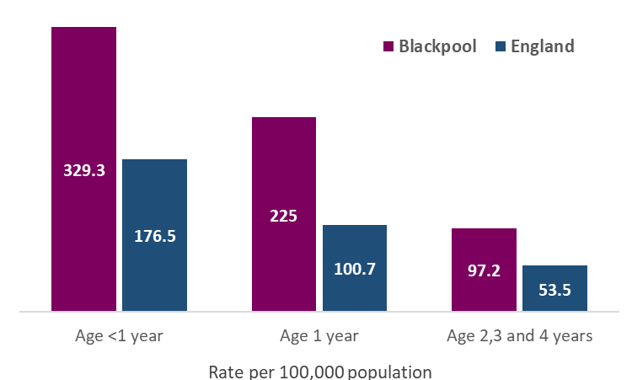
Overview
Maternal and Early Years Diet and Nutrition Paper (2018)
High levels of formula feeding
Low levels of breastfeeding
Early introduction of complementary foods
High levels of hospital admissions for gastroenteritis (below)
144 admissions across Blackpool in 2016/17
Significantly higher admission rates than the national average for all age groups
#learningtofeed

Slide 3
#learningtofeed

Slide 4
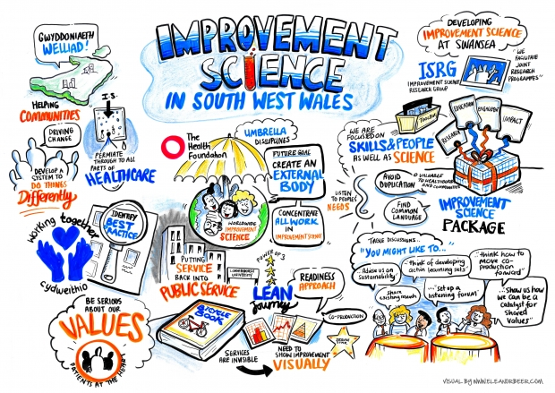
Improvement Science
Moira Inkles – University of California
#learningtofeed

Slide 5
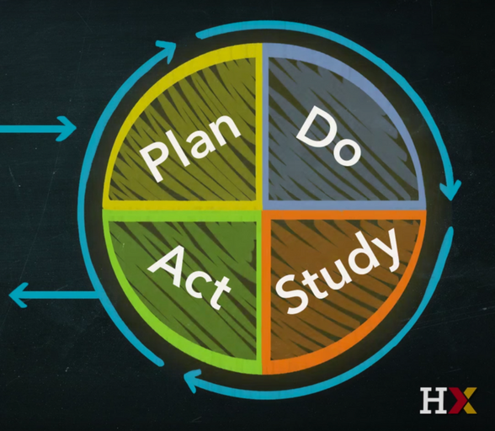
Mr Potato Head Exercise
Time
Accuracy
Improvements
Test…
#learningtofeed

Slide 6
Testing the Messages
Health Connector:
Took to co-producing a suite of community level infant feeding messages from recognised literature which looks at combating the town’s issues
Using the messages; visited a number of community venues testing how the message is received, heard and their thoughts and feelings
Offers to signpost parents if need be, to health professionals for further advice was given
Four cycles of testing was undertaken with antenatal parents, new parents, parents of older children and people in the pre conception years
Resulted in 6 community level messages that will be used by the L2F volunteers when the programme becomes live
#learningtofeed

Slide 7
Rapid Cycle Testing
“Are you saying I should hold my baby all the time?” (when feeding)
“Did not like the word disease in relation to babies. Sounds quite serious like ‘OMG If I don’t breastfeed my baby will get ill!”
“Hearing babies will wake up, it is nice to hear that it is normal. Other parents say that their babies sleep through.” One mum wondered was it her baby’s ethnicity that was a factor in him waking regularly.
#learningtofeed

Slide 8
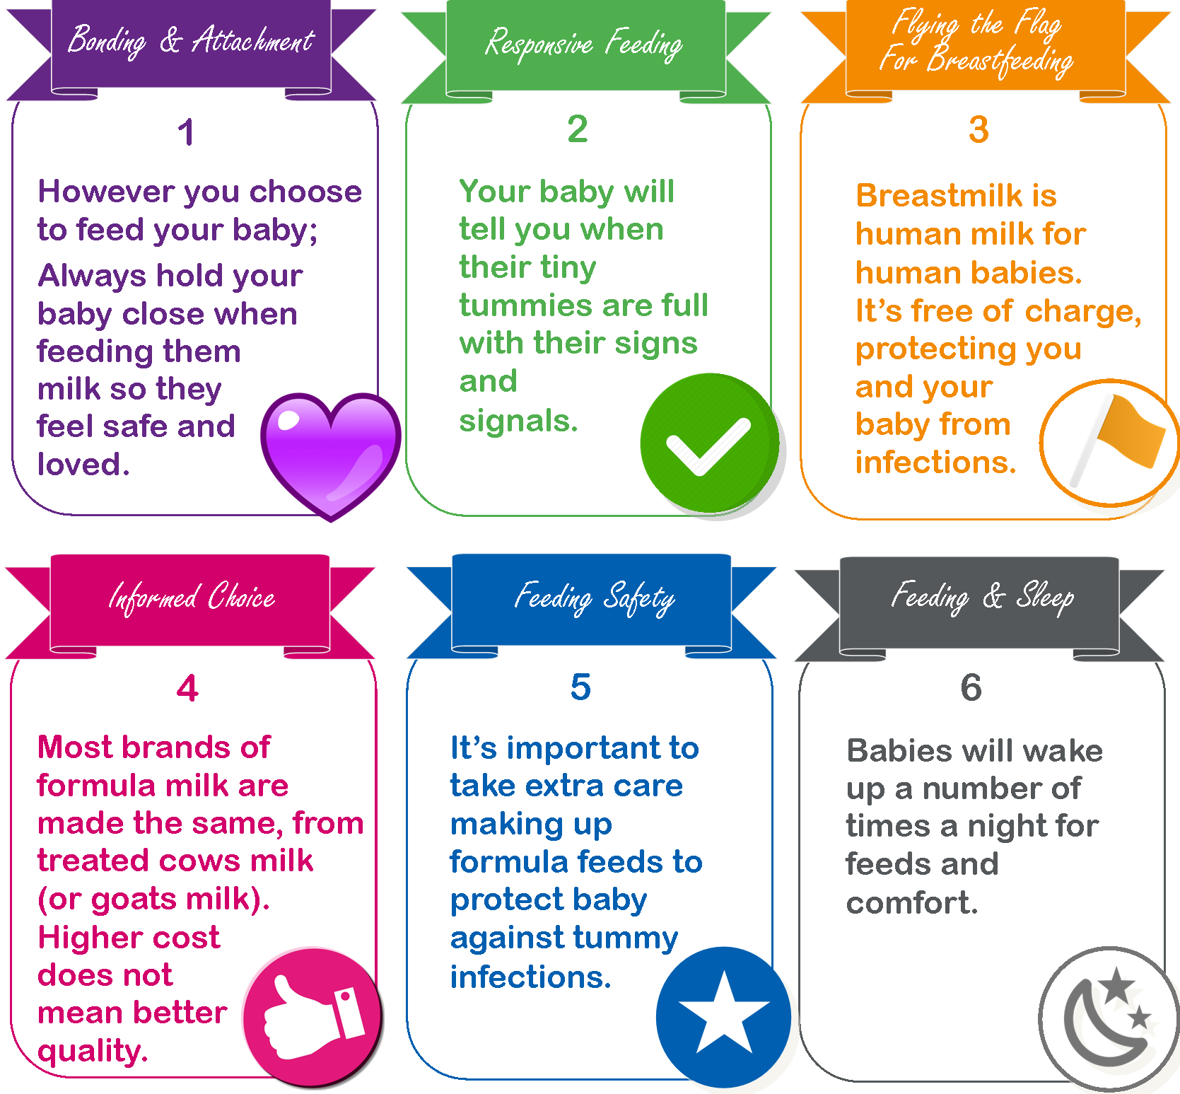
#learningtofeed
Notes:
Click #itmatters for Fleas in jar clip

Slide 9
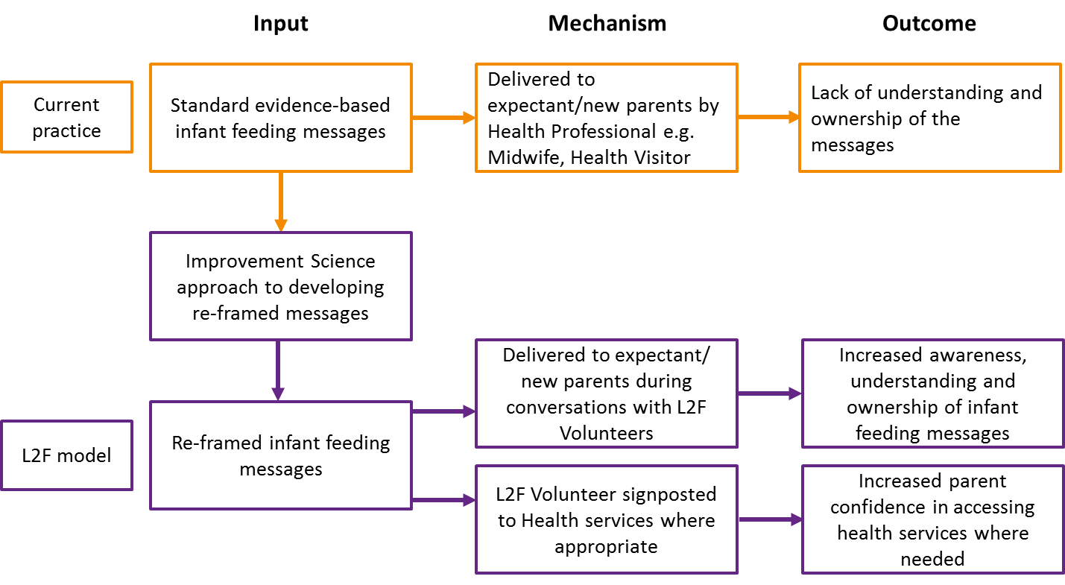
#learningtofeed

Slide 10
WHY the intervention is needed
High levels of gastroenteritis, low levels of breastfeeding, poor infant oral health and high ECC
Anecdotally, low levels of awareness of correct infant feeding
Anecodotally lack of time for universal services to focus on infant feeding and mistrust of messages from professionals
WHAT the intervention does
Disseminate key infant feeding messages by community volunteers through attuned and sensitive conversations and signposting to other health services
THROUGH
15-20 min conversation
TO
Expectant parents & new-born to 6 months across Blackpool
WHAT will the intervention look to achieve
Increased parent confidence in their infant feeding choices
WHAT are the intentded outcomes
WHAT are the intended long-term outcomes
Improvements in infant diet and nutrition through:
Increased awareness and understanding of infant messages
Increased parent understanding in accessing health services where needed
Will add value by being delivered through community volunteer seen as accessible and trusted messengers
Decrease in gastroenteritis and dental decay
Increased parent- child attunement
Secondary outcome: increase in breastfeeding
Improving child health
Improving child socio-emotional development
#learningtofeed

Slide 11
Evaluating the Pilot Phase
8 ‘Live’
Volunteers
8 Parents interviewed
30 Parents
Positive Feedback on Service Style
100% Agreed
to Research
Further 6 months
#learningtofeed

Slide 12
Next Steps…..
Victoria Walker: vicki.cecd@nspcc.org.uk
Twitter… @vicki_cecd
@CECDBlackpool
#learningtofeed

